Slide 1
Fall Communicators Meeting| November 2021

Slide 2
Our Discussion Today
Quad Introduction
Print Solutions Finding a Better Way
Subscriber Success
2

Slide 4
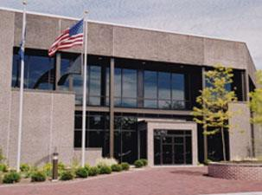
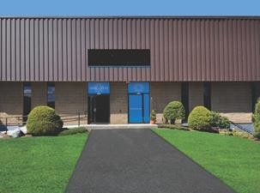
Deploying for Cooperative Living
Locations
Saratoga Springs, NY –
1MM sq. ft., 765 employees Magazines/SIPs, Catalogs, Retail, Premedia
Platemaking, Premedia, Web Offset, Saddle &
Perfect Binding, Co-mail, Distribution 91M sq. ft., 120 employees Commercial & Specialty Products
Premedia, Digital & Large Format Printing
Woburn, MA -
Tools/Services Client Connect - Digital Editions Flow/QR Codes
DBL Online, Mail and Bulk Tracking
4

Slide 5
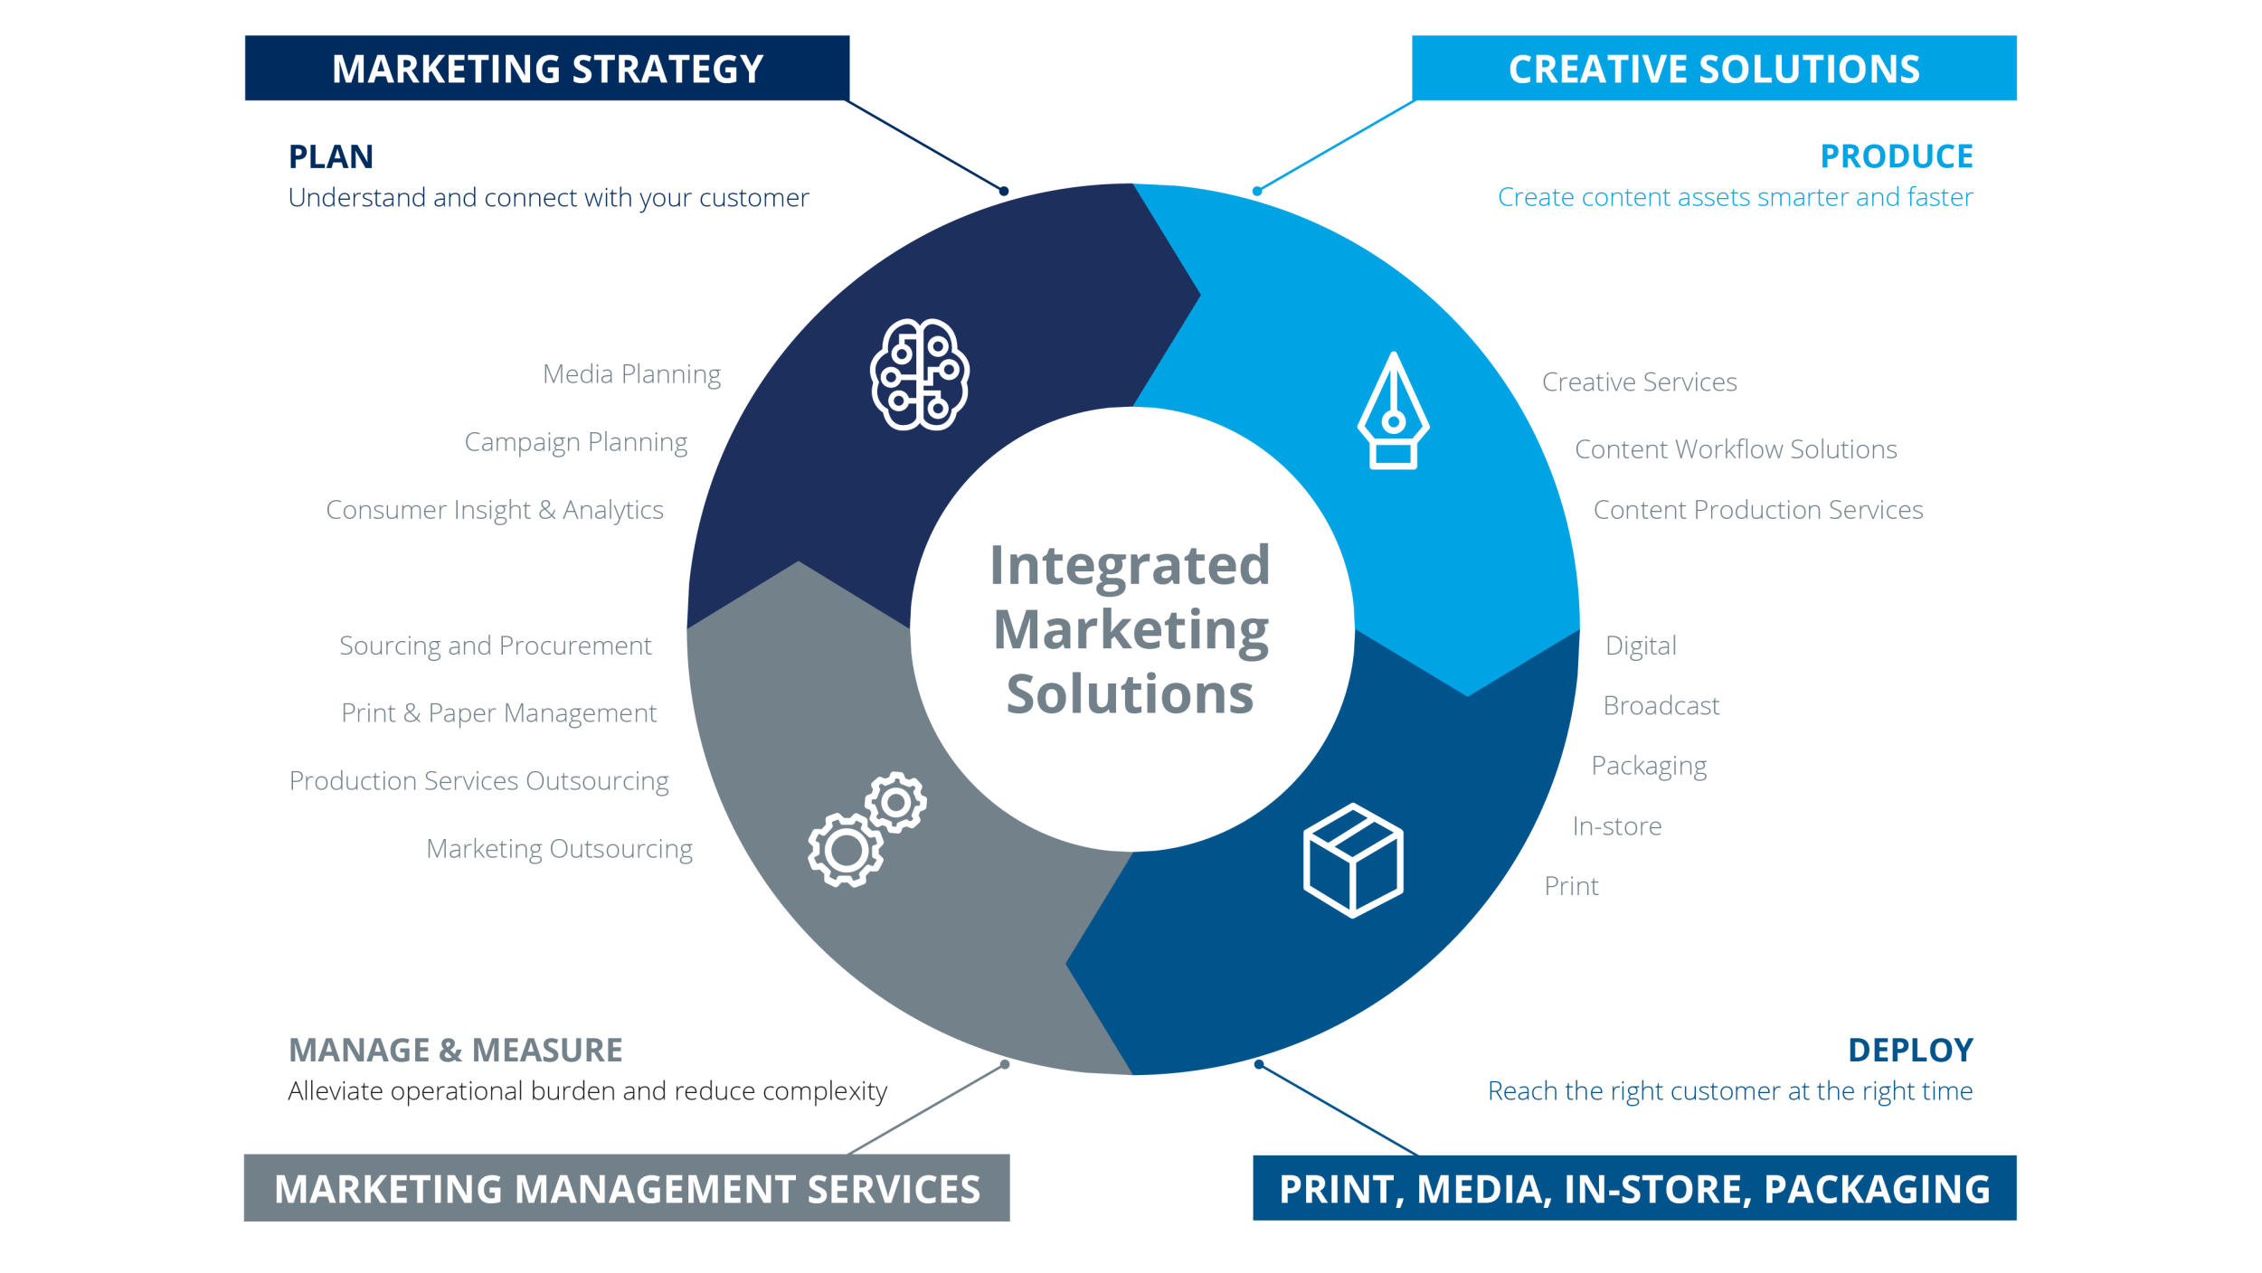
Quad Confidential & Proprietary | 5

Slide 6
Print Efficiency & Effectiveness
Connect Offline to Online Content
Advertising
LAMà® Displays & Signage
6

Slide 7
Integrate Your Online and Offline Message
QR Codes for Publications
Scan to Sign Up!
1:Many Code
Single code that can be placed on a page within a publication – same code for every member
Used per issue to link to subscription or sign-up page
online or other online content
Subscription or renewal pages
Videos
Feature content
Advertising
How can they be used?
To remove friction in sign-ups and renewals by using form auto-fills
More granular data & analytics
Scans by Day
Scans by Time and Location
Also, enables ability to deliver personalized content based on segments & audiences
Quad Confidential & Proprietary |
Quad Confidential & Proprietary |

Slide 8
Quad Confidential & Proprietary |

Slide 9
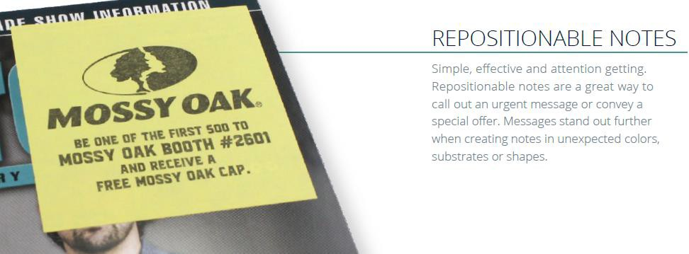
Quad Confidential & Proprietary |

Slide 10
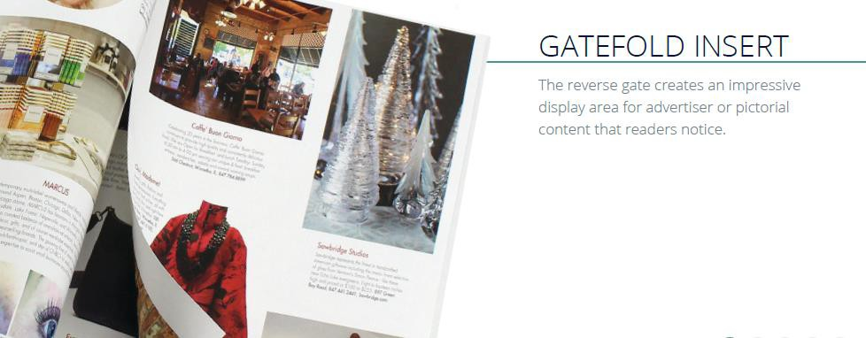
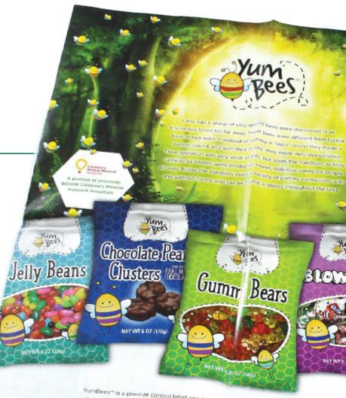
Quad Confidential & Proprietary |

Slide 11
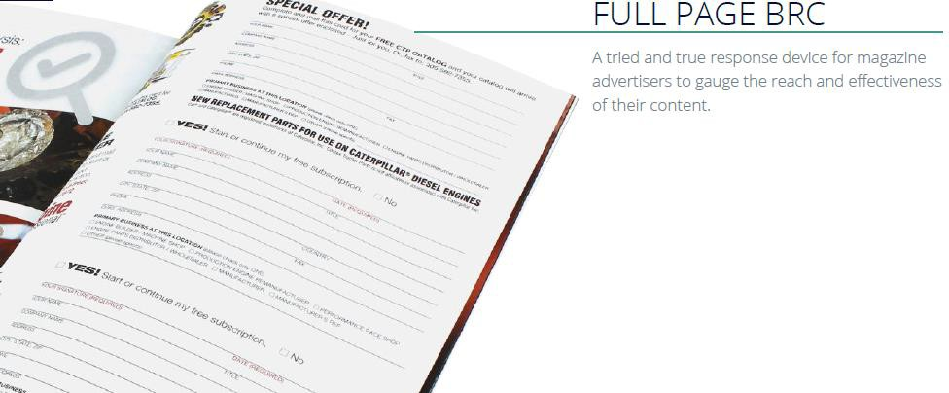
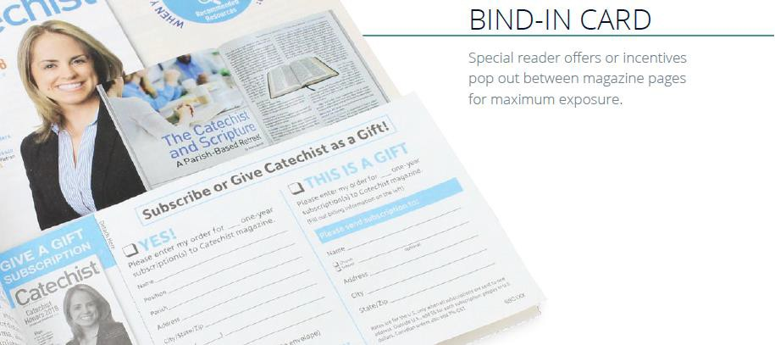
Quad Confidential & Proprietary |

Slide 12
Event Marketing
Brochure Holder Brochures
Self-mailers
Key Card Holders
Quad Confidential & Proprietary |

Slide 13
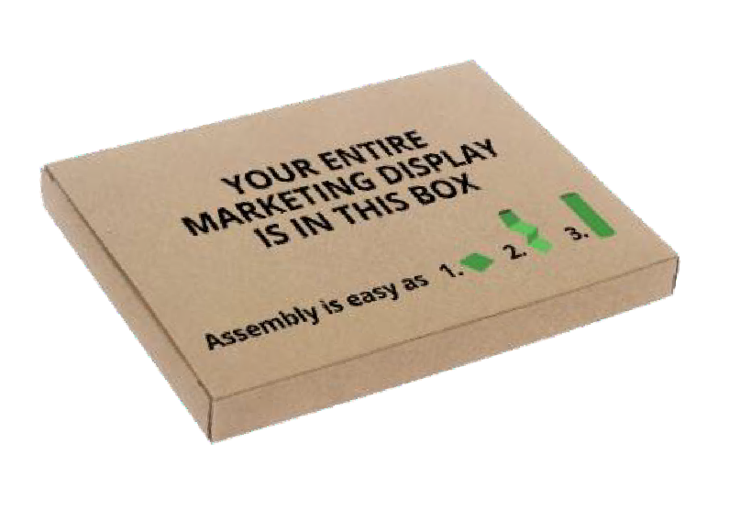
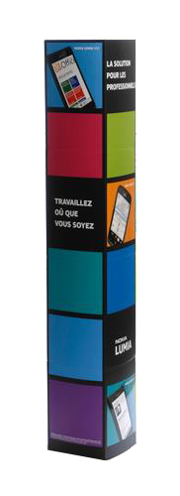
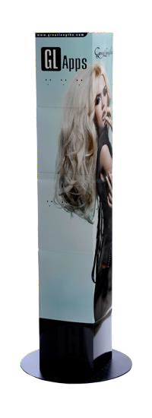
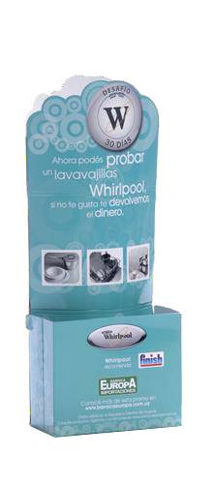
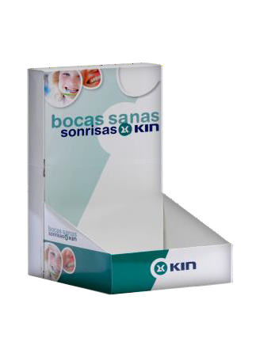
LAMà® Displays
Patented LAMà® Displays are instant displays that fold and
ship flat, effortlessly and properly set-up in seconds.
Available in a wide range of shapes, sizes and innovative solutions, LAMà ® Displays can be easily modified through a variety of enhancements and customized solutions.
Benefits
Folds Flat & Cost Effective to Ship | Instantly Flawless High In-Store Compliance | Lightweight Portable | Easily Enhanced Fully Customizable
Quad Confidential & Proprietary

Slide 14
Finding a Better Way
Postal Solutions
14

Slide 15
Cooperative Mailing is a winning strategy in controlling delivery costs. By working together, we reduce the cost of delivering your publications.
Pool Shipping:
Shared trucks
Co-palletizing:
Shared containers (skids)
Multi Mailing:
Shared Carrier Route bundle maximizing least expensive USPS piece rates
Multi Mail (no poly)
Multi Wrap (with polybag)
Shared Mail:
Shared polybag package delivered by the USPS
Demo Binding:
Combined versions to reduce sacks/postage and improve delivery
Doorfront Direct: Shared polybagged package delivered outside the USPS
All these techniques work by leveraging the aggregate mail volume of Quad’s customers with existing equipment and optimization logic at Quad, and Quad’s procurement power and partnerships with truck carriers and alternate delivery vendors.
Finding the best combination of these money-saving tools for your publication is our goal.
Quad Confidential & Proprietary | 15
Quad Confidential & Proprietary |

Slide 16
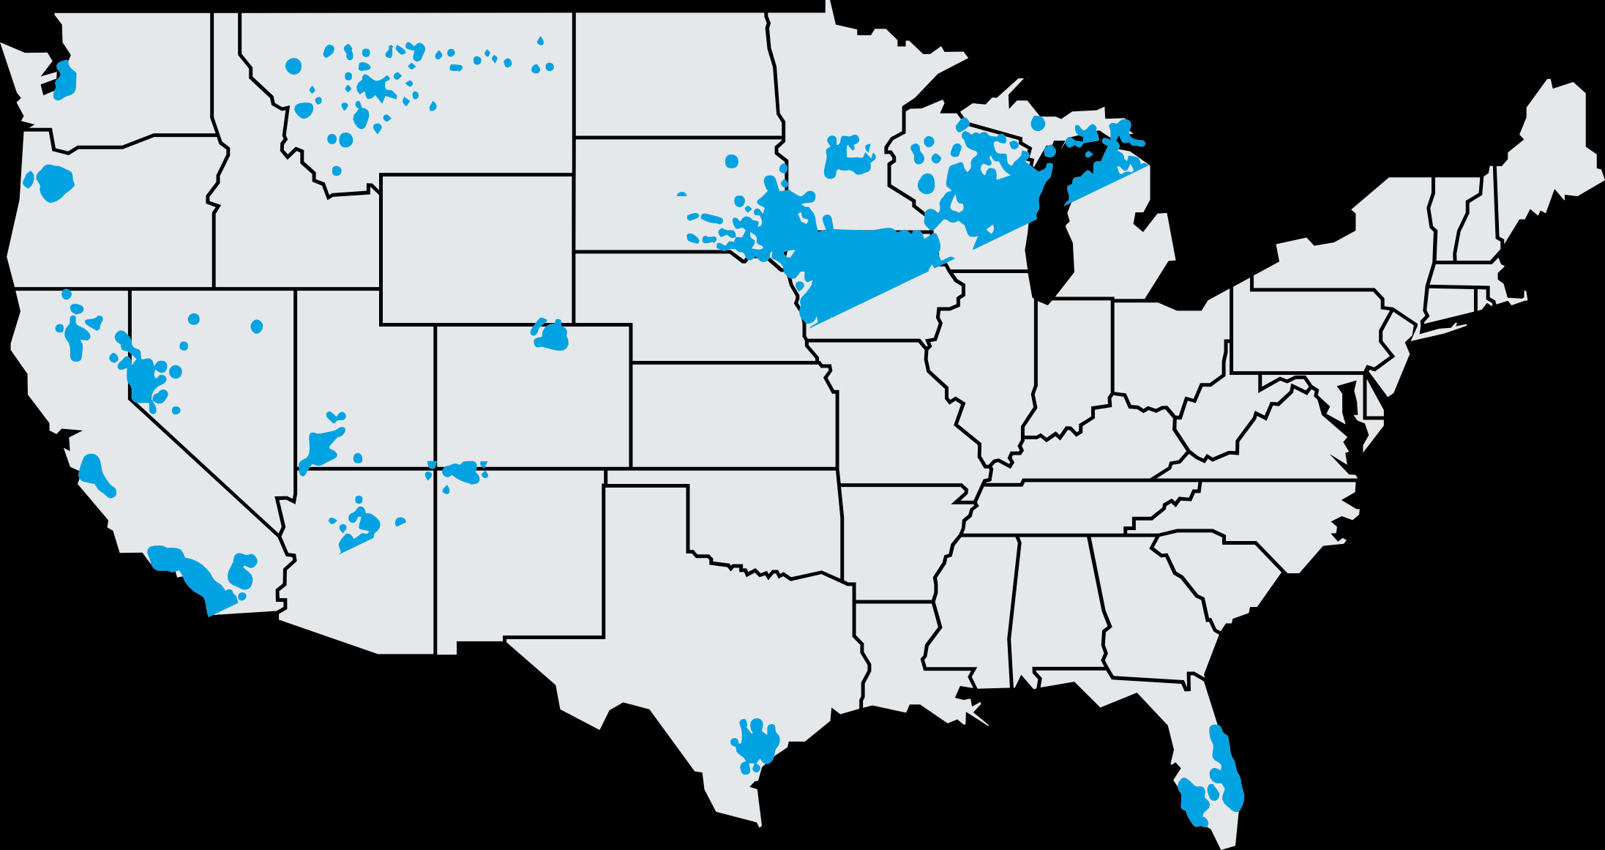
Current Markets Coverage Map
10%
Planned Growth
Per Quarter
Quad Confidential & Proprietary | 16

Slide 17
Subscriber Success
List Acquisition Direct Mail Formats
Incorporating Digital Marketing
17

Slide 18
Gain more subscribers with an updated approach
Leverage digital to drive increased awareness
Build awareness for self purchase AND for gift giving
Align your message across multiple channels
Direct Mail – tell your story
Paid Social / Paid Search – find your audience
Digital Advertising
Reinforce and remind (retarget) Direct Mail Recipients
Create community and interest in your publication
Test first to learn what works
Model your existing customers to better understand your prospects
Integrate channels for increased response
Quad Confidential & Proprietary |

Slide 19
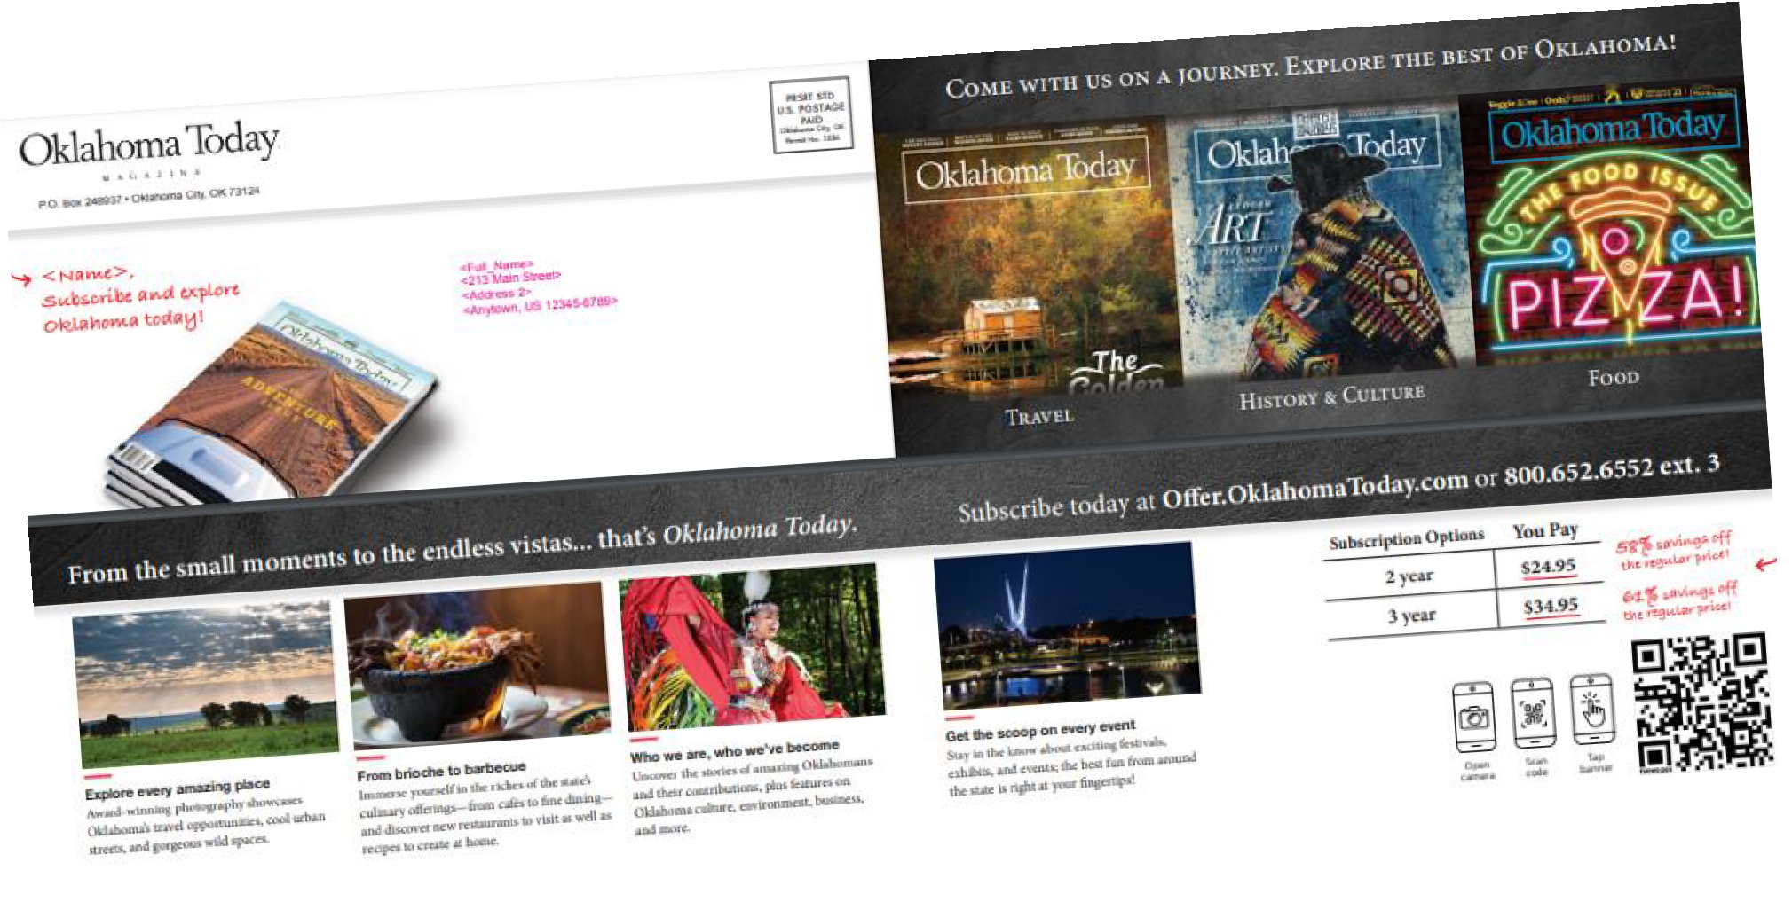
Combined mail/digital campaign boosts subscribers & revenue.
OKLAHOMA TODAY MAGAZINE | CASE STUDY
“
“ We’re always looking to
grow our subscriber base
and this program really
worked. I was so impressed with everything the Quad team did, from the planning to the creative, the messaging, all the way through the execution.”
— Colleen McIntyre, Director of Operations
CHALLENGE: As the official state magazine, “Oklahoma Today” covers notable events, attractions, food, history and culture. Maintaining its paid 16,000 circulation, attracting new subscribers and increasing ad revenue is a constant quest, a challenge many smaller special interest publications with limited staff face.
SOLUTION: Quad’s SIP team proposed an audience development program that combined optimized direct mail with digital media. The team analyzed the current subscriber database to identify best customers, then recommended which additional lists to buy to find “look-alike” prospects. A direct mail piece with a flowcode people could scan to subscribe kicked off the campaign, which included paid search and social, and programmatic display.
IMPACT: The program generated massive social engagement and drove traffic to the Oklahoma Today website. Those visits converted into new subscriptions and renewals. Compared to previous campaigns, there was a 197% increase in new orders, a 23% increase in renewals and a 71% increase in revenue.
in new orders
Quad Confidential & Proprietary | 20

