Slide 1
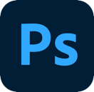
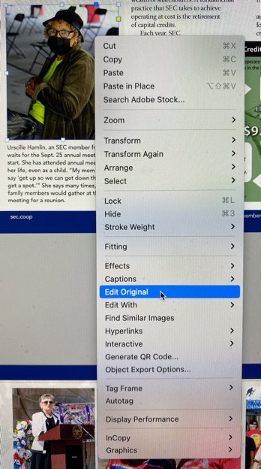
Correct Photo Specs
Right-click on photo
Select Edit Original or Edit With > Photoshop

Slide 2
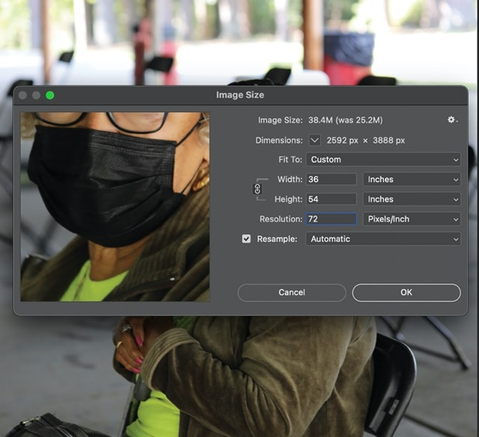
Correct Photo Specs
Select Image > Image Size from menu
Large image dimensions
Low image resolution
Image is much larger than needed
Needs to be compressed

Slide 3
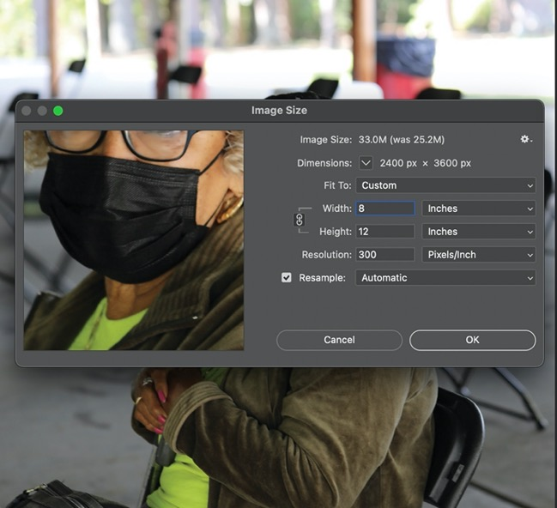
Correct Photo Specs
Reduce width closer to needed size
Height will automatically adjust
Ensure size format is ‘locked’
Increase Resolution to at least 240* *PPI of 199 minimum

Slide 4
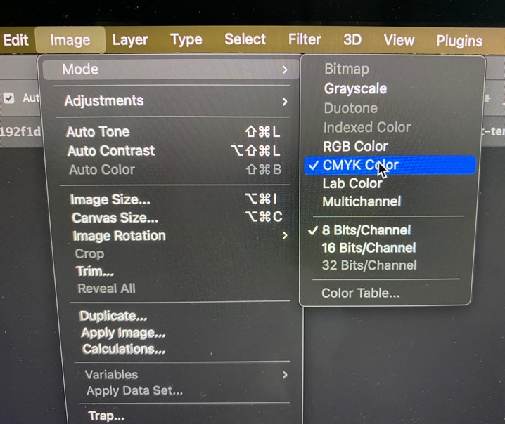
Correct Photo Specs
Check color mode
Image > Mode > CMYK Color
Save file, size will increase

Slide 5
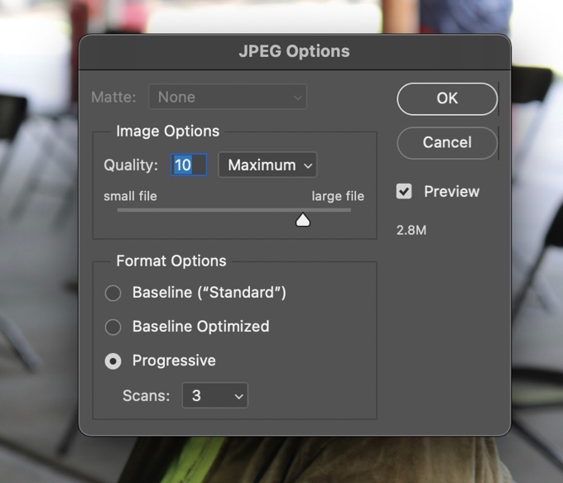
Correct Photo Specs
Use slider to change quality/size
Check size based on needs

