Slide 1
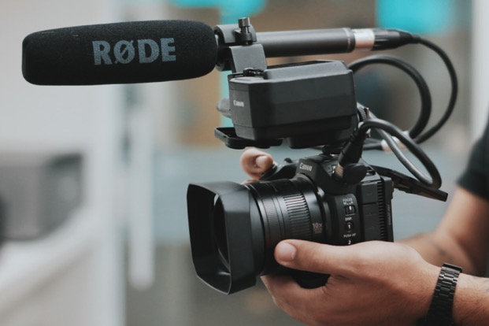
Videography Tips
Get closer, avoid zoom option, esp. with phone
Smooth, constant panning
A little extra at the end
Change up your perspective
Avoid long clips

Slide 2
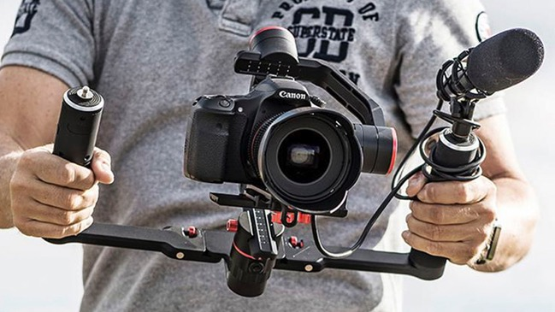
Videography Tips - DSLR
24fps > 1/50 shutter speed
60fps > 1/120 shutter speed
Stabilize
Constant movement w/o tripod

Slide 3
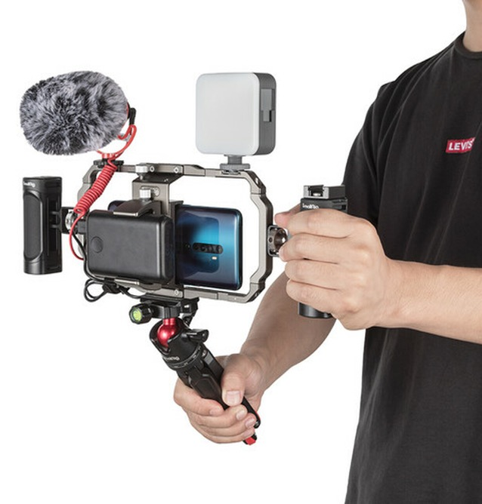
Videography Tips - Smartphone
1080p good choice, 4k
Tuck elbows into sides
Stabilizer
Do not use zoom
Keep moving

Slide 4
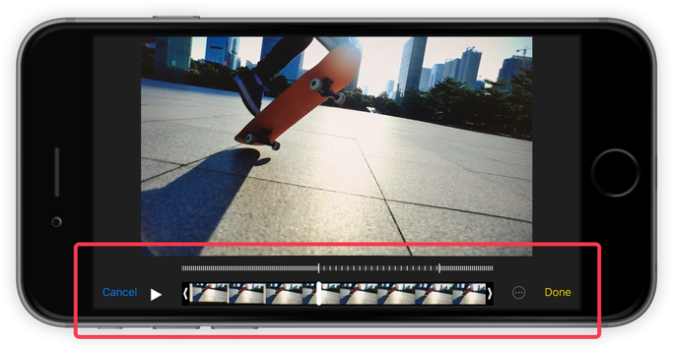
Videography Tips - Smartphone
Crop ends
Adjust exposure, etc.
Use iMovie or Premiere
AirDrop or Export

