Slide 1
cooperative.com/yame

Slide 2
Let’s Talk About…
YAME
What is it?
Why is this a thing?
How was this created?
How can it help me?
cooperative.com/yame

Slide 3
YAME
“Young Adult Member Engagement”
Joint initiative from NRECA and Touchstone Energy
Outgrowth of Lexicon project
cooperative.com/yame

Slide 4
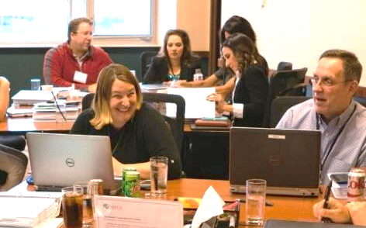
About the YAME Initiative
Goals:
1) Foster adaptive culture
2) Boost engagement
3) Increase involvement
Two phases:
1) Externally focused
2) Internally focused
Content: Research & resources
cooperative.com/yame

Slide 5
Why Focus on Young Adults?
Changing demographics
cooperative.com/yame

Slide 6
Co-op Members
Co-op Employees
20% of Co-op Employees Eligible
for Retirement in 2020
Heads of House
Current
Workforce
Baby Boomers & Generation X
Generation Y &
Generation Z
Total Population
New Hires
Source: 2020 estimates based on NRECA data
cooperative.com/yame

Slide 7
U.S. Median Age, 2019
Total 38
Female 39
Male 37
32% of the U.S. population is 21-44
Only 16% of the U.S. population is 65+
Source: Census.gov

Slide 8
Why Focus on Young Adults (Members & Employees)?
Changing demographics
Lower satisfaction scores among this age group
Stiff market competition to reach this group
Shifting societal and consumer expectations affect all age groups
cooperative.com/yame

Slide 9
Today’s Members Expect…
Today’s Workforce Expect…
Independence
Transparency
Respect
Family-friendly
Technology
Convenience & saving money
Giving back
Autonomy
Feedback (give & receive)
Respect & recognition
Diversity & inclusion
Education & professional development
Competitive benefits & compensation
PURPOSE! (something larger)
cooperative.com/yame

Slide 11
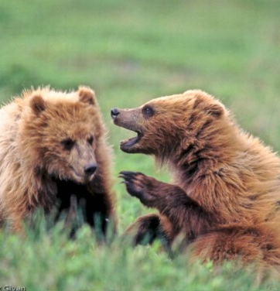
Let’s Chat
How have you seen these evolving expectations taking hold at your co-op?
cooperative.com/yame

Slide 12
Phase 1: Externally Focused
Provide co-ops with engagement resources that tell a modern cooperative story that resonates with members and stakeholders.

Slide 13
Phase 1 Overview
WHO are young adult members
WHAT drives engagement with the age group
WHY co-ops should engage this group
HOW you can take steps at your co-op to engage with this group

Slide 14
Research to Inform YAME Strategy
Advisory committee
Touchstone National Survey on the Cooperative Difference
Lexicon Research
Six focus groups of young adult co-op members (Idaho, Kansas, Michigan, Missouri, Ohio, Washington)

Slide 15
Focus Group Takeaways
Community is key; history doesn’t engage
Core values matter most
They value your products & services, but don’t always know about them

Slide 16
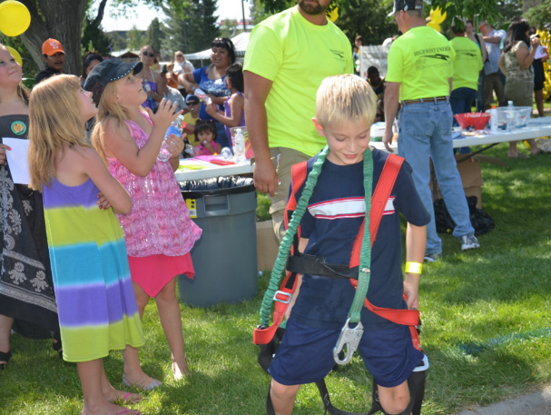
Focus Group Takeaways
Use multiple channels, multiple times to reach them
Give them options and make it easy
Meet them where they are, and make it personal

Slide 18
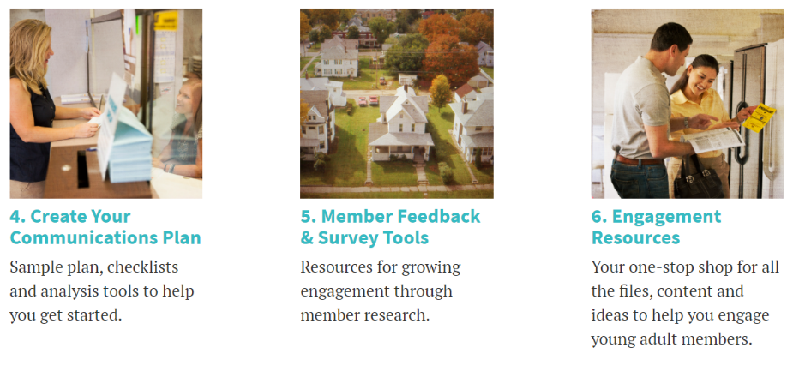
YAME Phase 1 Resources
The WHY
The WHAT
The HOW
Create Your Communications Plan
Member Feedback & Survey Tools
Engagement Resources (including Idea Bank)
cooperative.com/yame

Slide 20
Phase 2: Internally Focused
Help co-ops develop and nurture a workforce and organizational culture that are effective at meeting evolving member expectations.

Slide 21
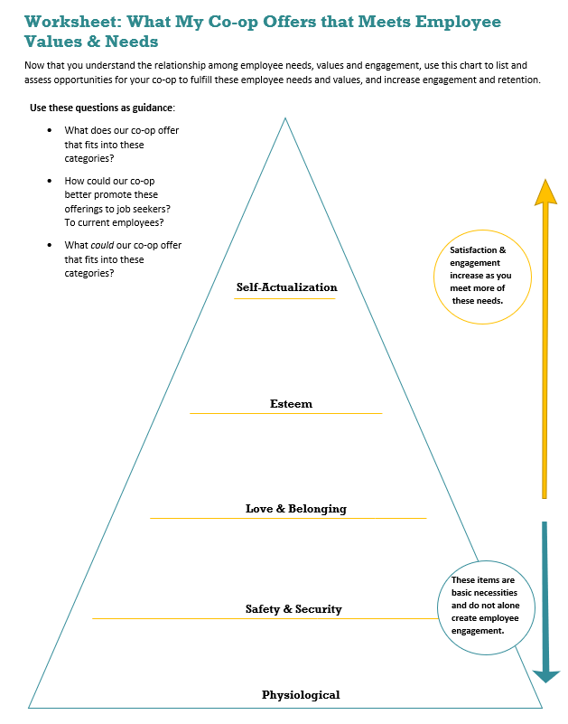
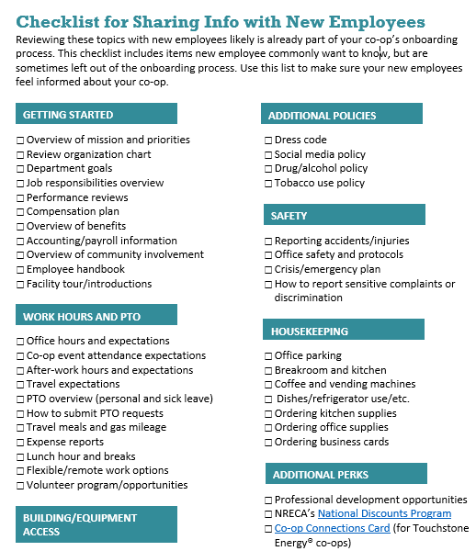
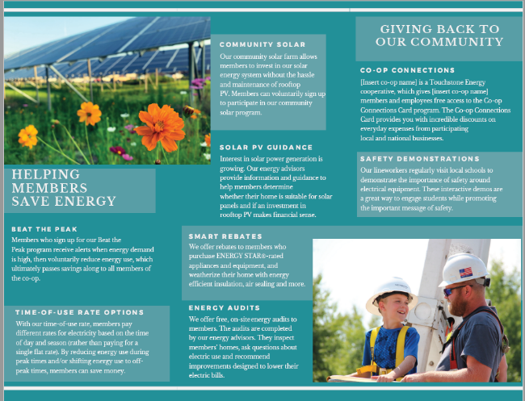
Phase 2 Overview
Employer branding, talent acquisition and onboarding
Ongoing employee education for new and tenured staff
Culture development toolkit designed for leaders
cooperative.com/yame

Slide 22
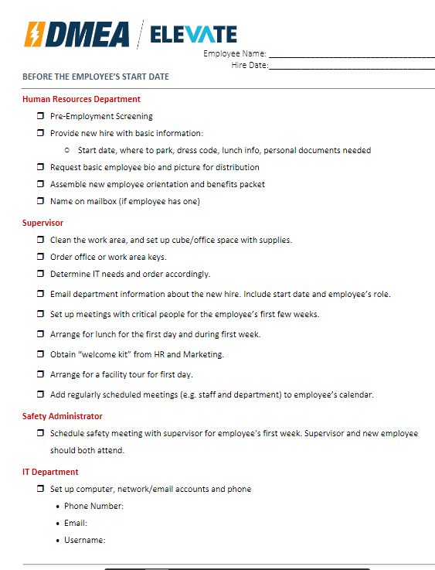
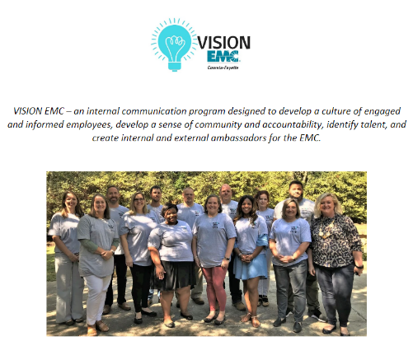
Research Guided by Members
Feedback from more than 100 members
Workforce advisory group
YAME advisory group
cooperative.com/yame

Slide 23
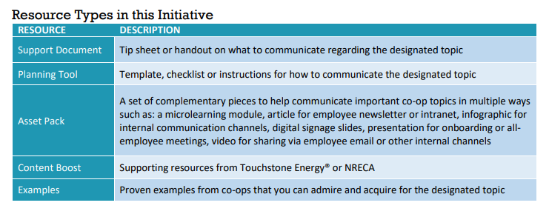
Phase 2 Resources
70+ downloadable resources
All customizable
Broken down by topic & type
In strategic order
Incorporated into 2 plans:
Onboarding new employees
Ongoing education for tenured employees
Help employees be knowledgeable & use a common/consistent language

Slide 25
Let’s Start Thinking!
What do I want to help my co-op do differently?
Build up our employer brand in the community
Have an extensive onboarding plan for new hires
Better educate employees on the co-op and its programs
Break down organizational silos
Improve the co-op’s culture
What resource(s) am I most interested in revisiting?
Which resources could promote collaboration in my co-op?
cooperative.com/yame

Slide 26
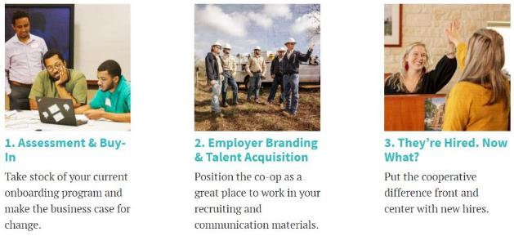
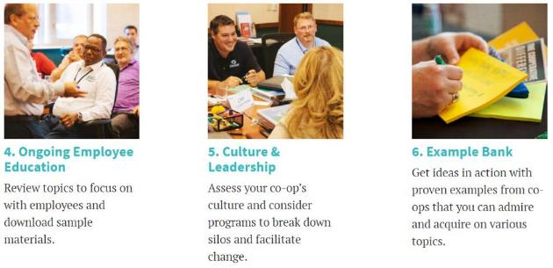
A Look Inside the 6 Areas
cooperative.com/yame

Slide 27
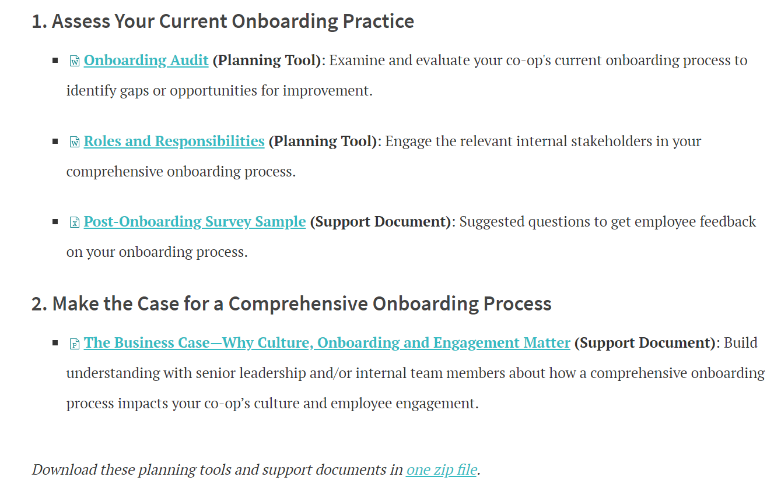
1. Assessment & Buy-In
Planning tools and resources to help answer:
What’s the business case?
Who should be involved?
Where do I start? (hint: with an audit!)
cooperative.com/yame

Slide 28
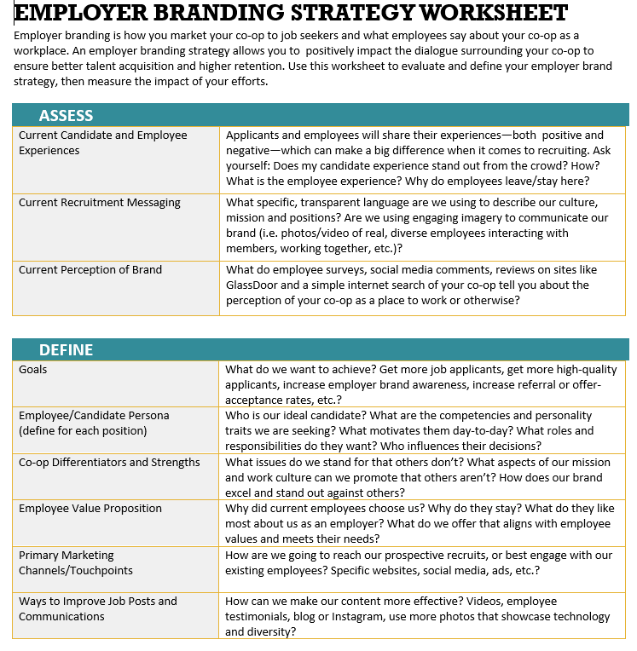
2.Employer Branding & Talent Acquisition
Planning tools and resources to:
Assess and improve your employer brand
Understand and leverage employee values and needs
Create engaging communications to recruit the right talent
cooperative.com/yame

Slide 29
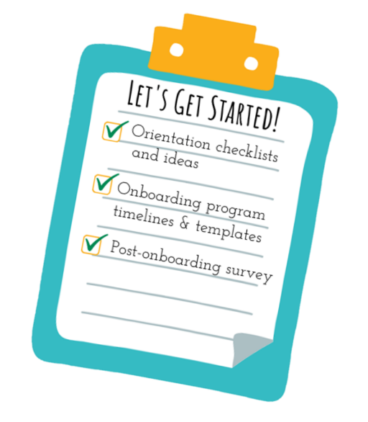
3. They’re Hired. Now What?
Planning tools and resources to:
Welcome Idea List
Start Partner Program
First Day Checklist
Supervisor Checklist
Elevator Speech
cooperative.com/yame

Slide 30
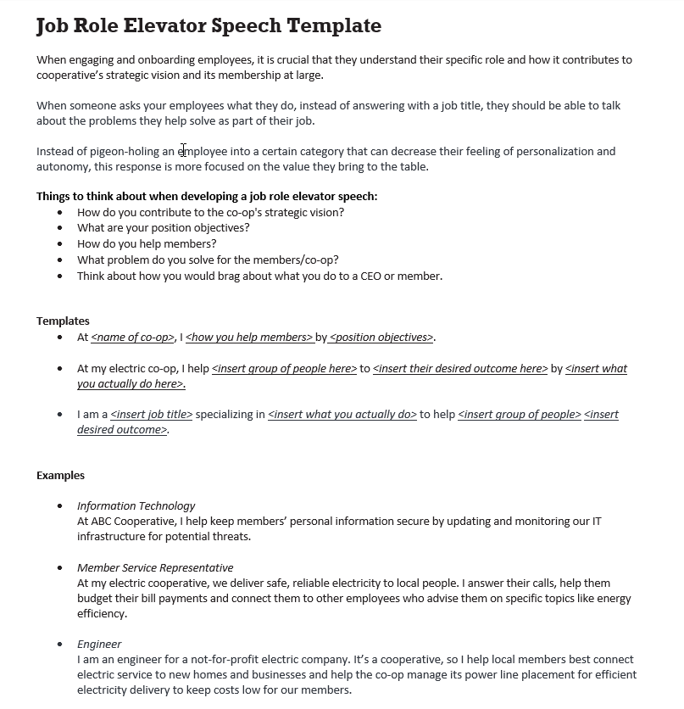
Resource: Job Role Elevator Speech
Help employees understand their impact simply, personally & positively
cooperative.com/yame

Slide 31
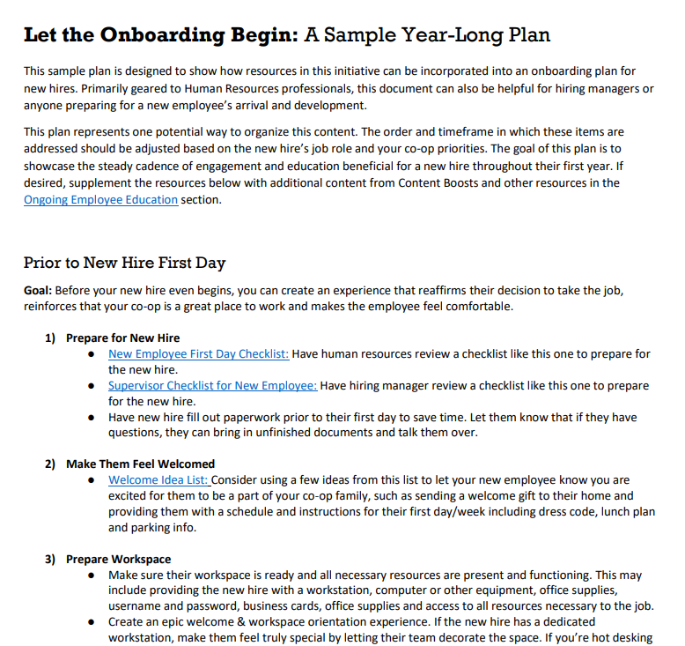
Resource: Yearlong Onboarding Plan
First day
First week
First 30 days
1st, 2nd, 3rd & 4th Quarters
First Anniversary
cooperative.com/yame

Slide 32
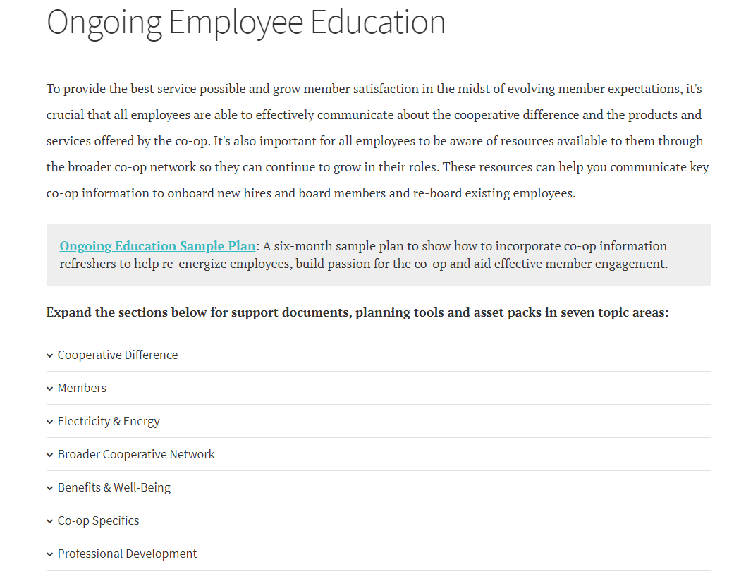
4. Ongoing Employee Education
Seven topic areas co-ops told us are most important for new & tenured employees to be knowledgeable about
cooperative.com/yame

Slide 33
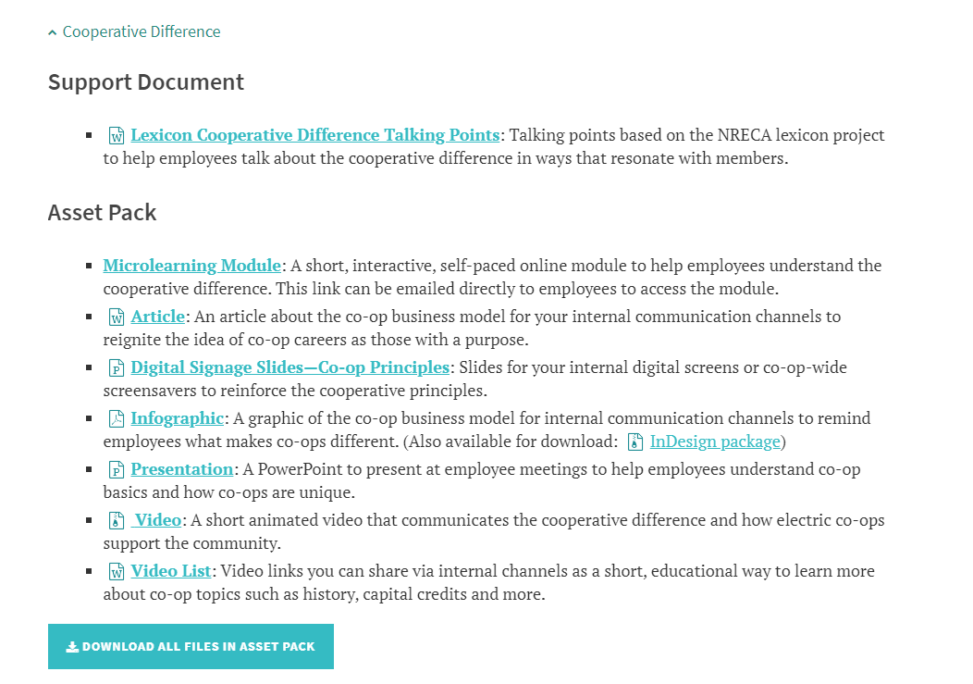
Resource: Asset Pack
What’s in it
For multiple channels
Suggestions for use
Easy to repurpose
cooperative.com/yame

Slide 34
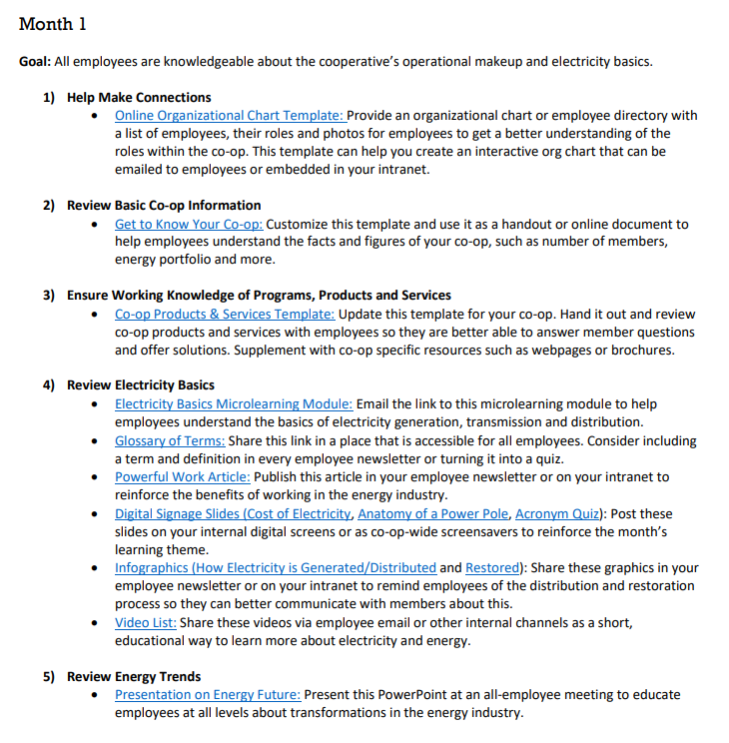
Resource: Ongoing
Education Plan
Re-engage employees:
Six months
Sorted by goal
Other ideas for throughout the year
Tips to execute
cooperative.com/yame

Slide 35
Add fire hydrant slide add site map download info

Slide 36
5. Culture & Leadership
Various resource types
(Checklists, discussion guides & more)
In strategic order
To help with:
Why culture matters
Types of successful cultures
Taking first steps
DIY culture survey toolkit
cooperative.com/yame

Slide 37
cooperative.com/yame

Slide 38
5. Culture & Leadership
Why does culture matter?
Types of successful cultures
Taking the first steps
DIY culture survey toolkit
Checklists and discussion guides
cooperative.com/yame

Slide 39
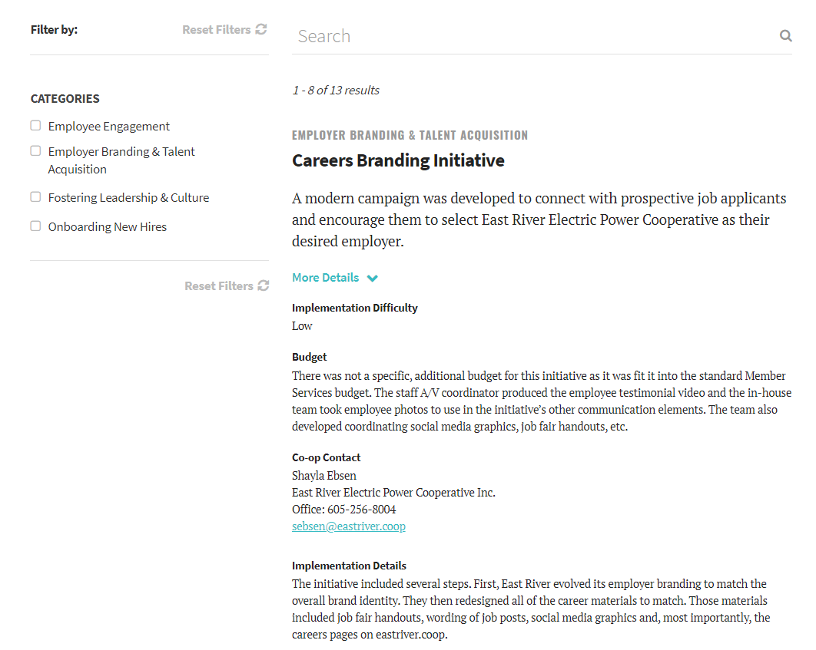
6. Example Bank
Get ideas in action with proven examples from peers that you can admire and acquire on various topic areas
cooperative.com/yame

Slide 40
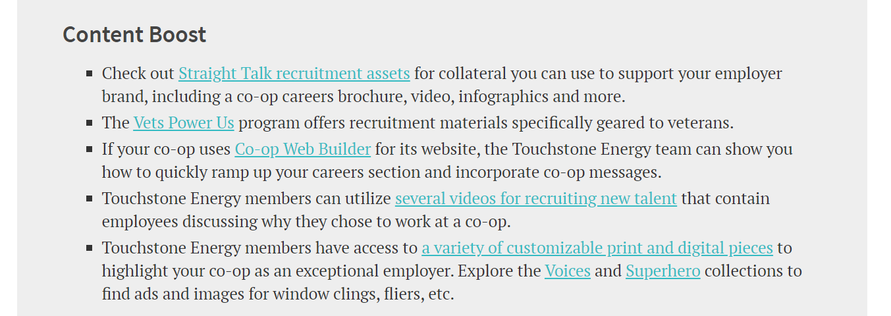
Content Boosts
Additional existing resources from Touchstone Energy® and NRECA to help meet the goals of this initiative.
cooperative.com/yame

Slide 41
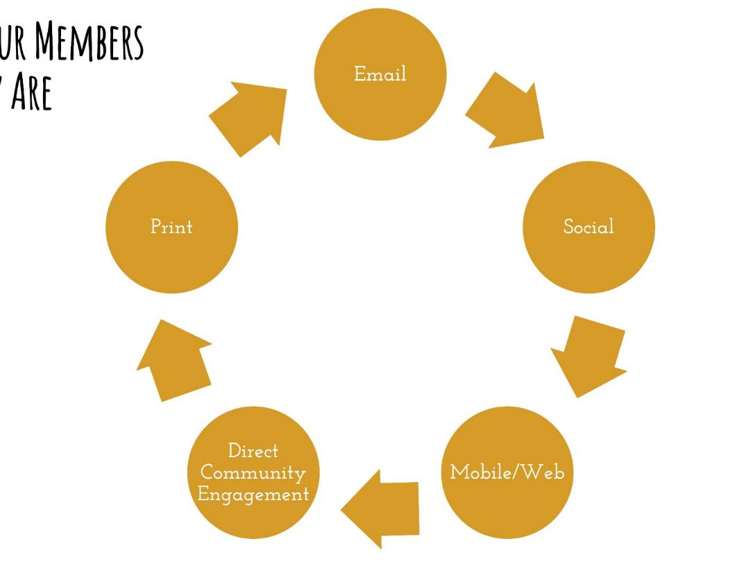
What Can We Do to Engage Members & Employees?
Communicate the Cooperative Difference The best advantage we have for hiring, engaging, and mobilizing! (Internally & Externally)
​Ensure employees are knowledgeable about the co-op If it doesn’t resonate with employees, you can’t expect it to resonate with members
Meet them where they are Use multiple channels (7x7)
Utilize YAME & Lexicon Resources Use simple language that resonates (speak in a future voice; emphasizing local, community ties)
Meet them where they are
cooperative.com/yame

Slide 42
Cooperative.com/YAME
Maura.Giles@nreca.coop

