Slide 1
Digital Media
Connections
Flowcodes
Online Directory
Legislative Guides
Digimags
E-newsletters
co-opliving.com redesign

Slide 2
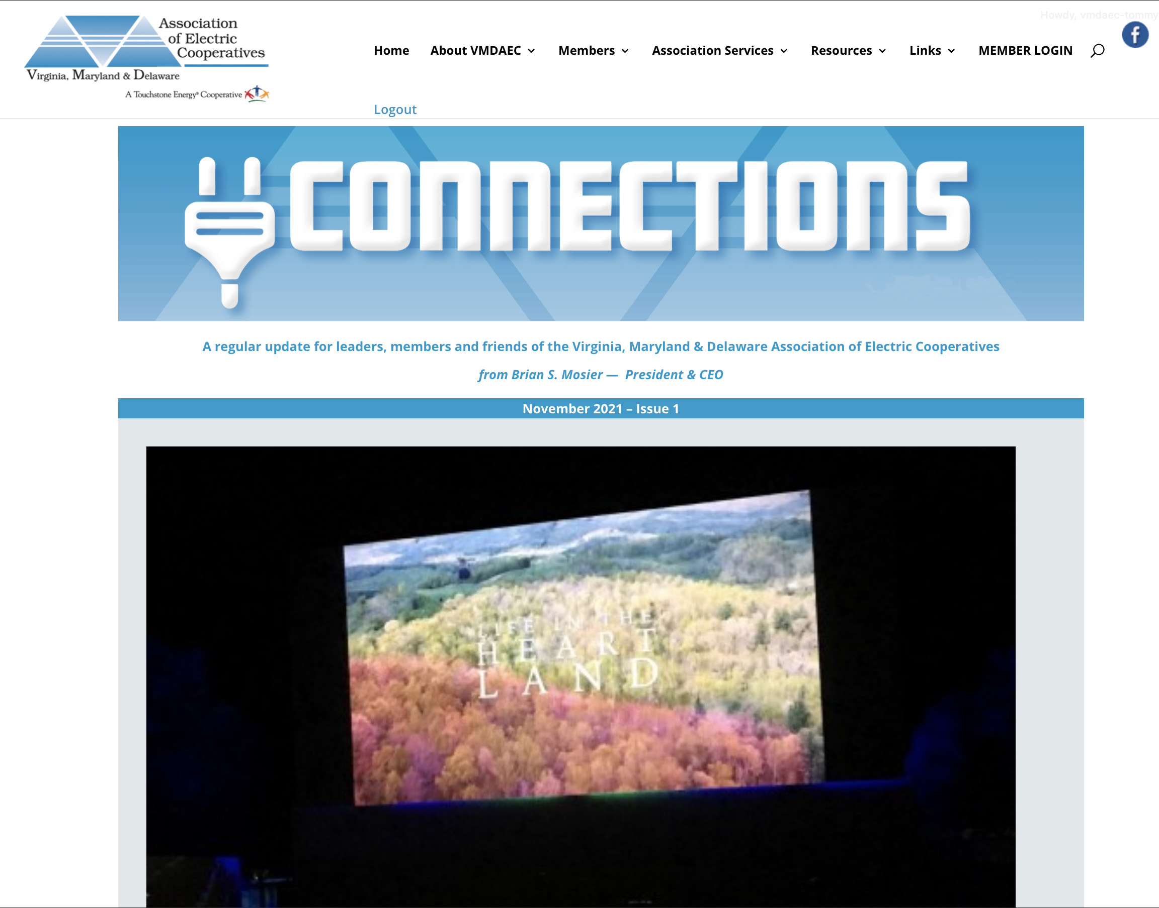
Connections
vmdaec.com/connections/
Published twice a month
Blog style
Easy to share, print and save articles
Up-to-date information
Photo Galleries
Videos
Links

Slide 3
Connections
vmdaec.com/connections/
From October 1st until November 15th (3 issues) - 1,854 Pageviews
We send out approx. 300 emails each issue

Slide 4
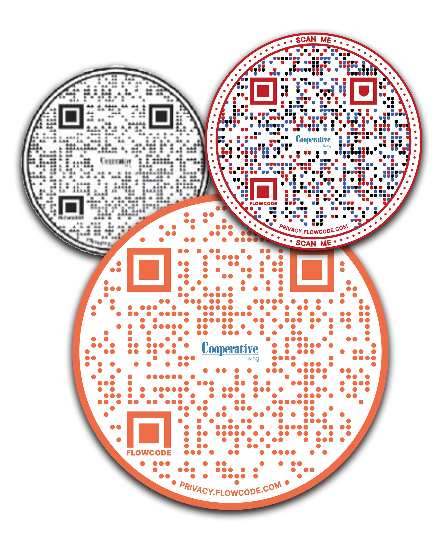
Flowcodes
Easy way to share information
Direct people online to read more, photo galleries, videos, online surveys and much more
Makes that connection between the print and digital platforms
Very easy to use with today’s technology

Slide 5
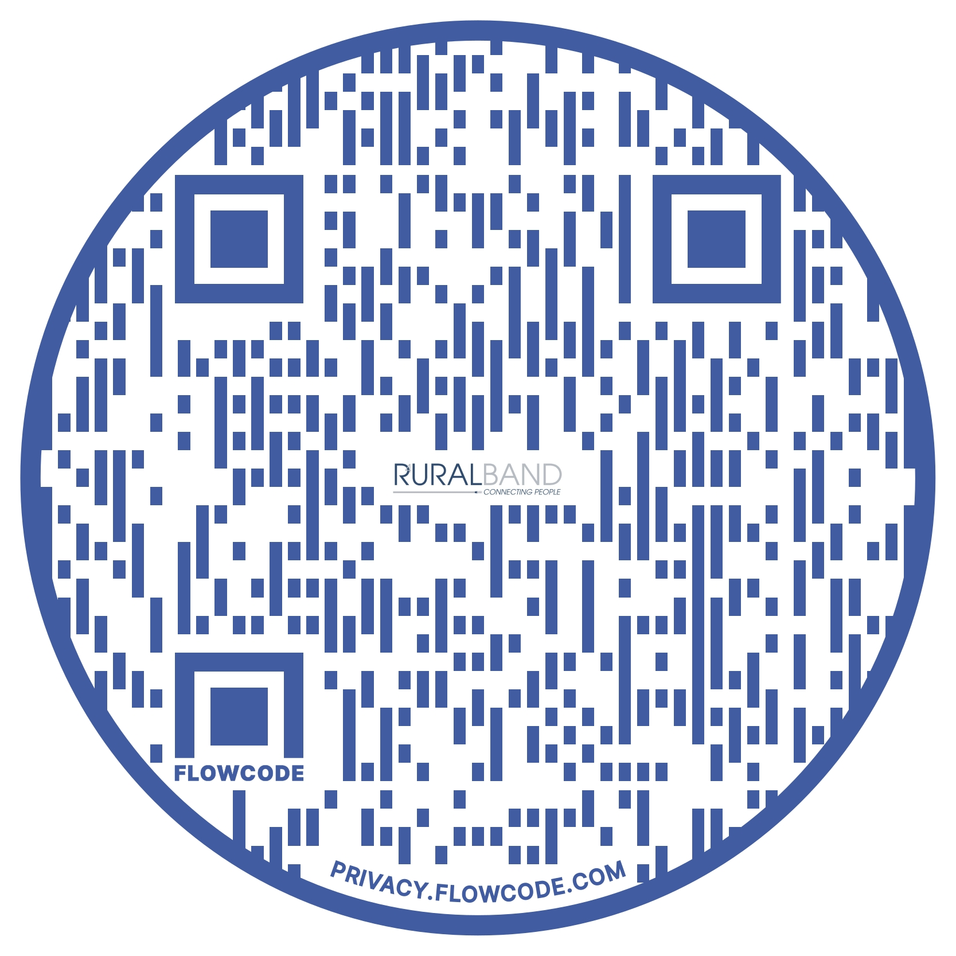
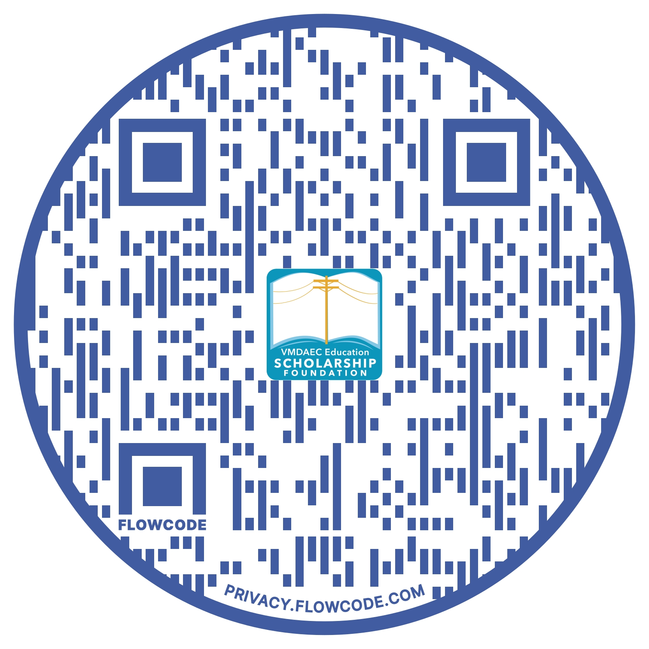
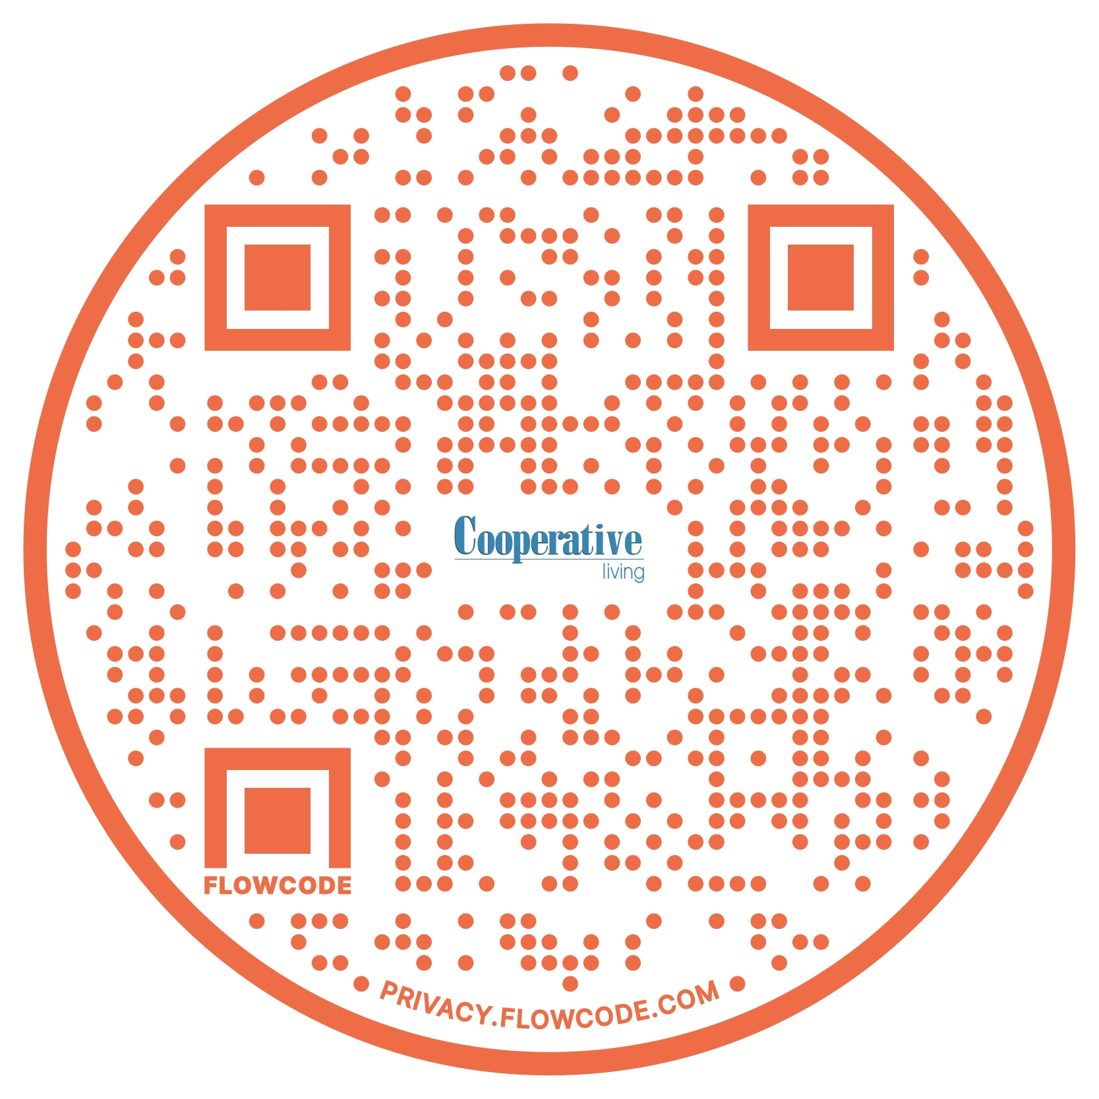
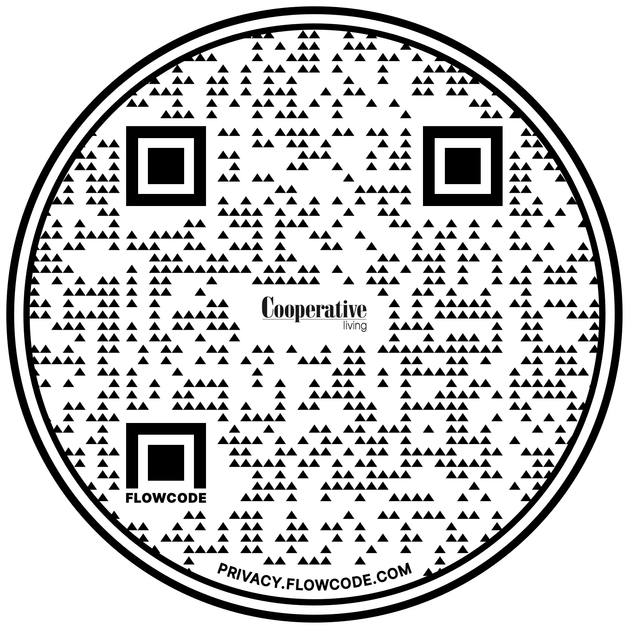
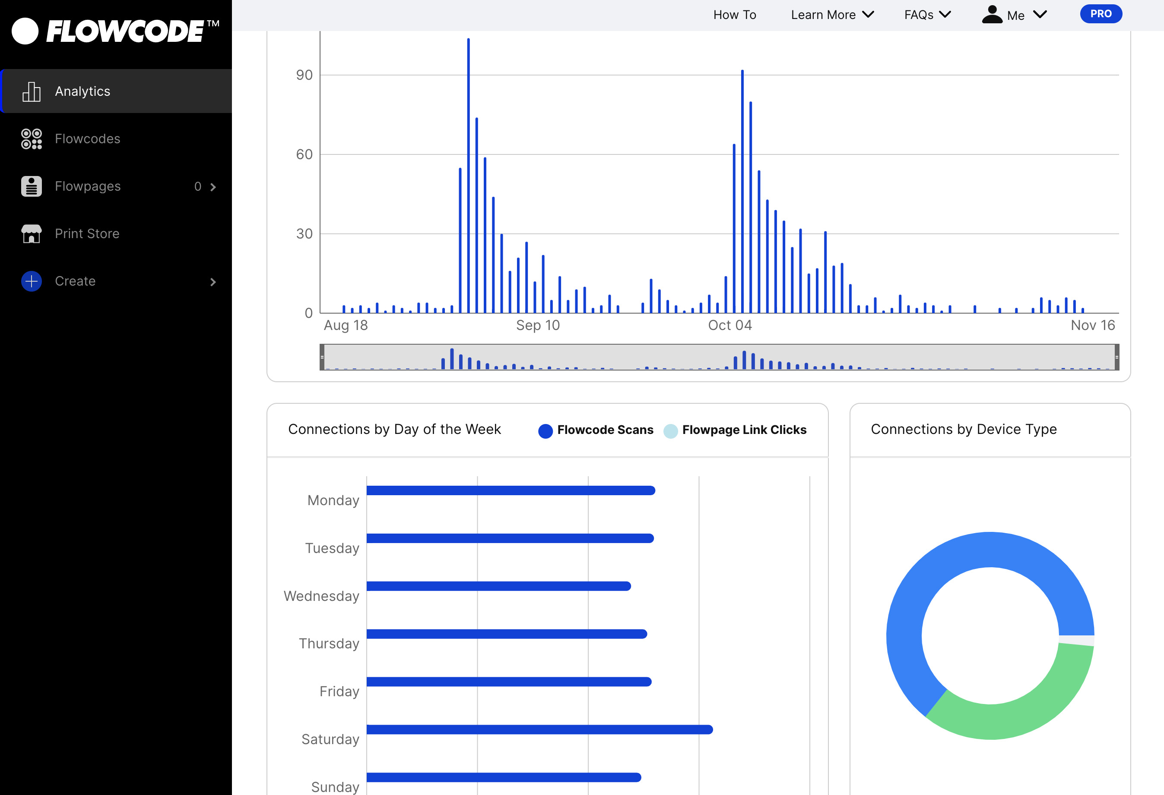
Flowcodes
Can be used in multiple places
Analytics & Data
Scholarship Donations
2021 Fall Travel &
Festival Guide
PGEC Ruralband
Ice Cream Trail
1,258

Slide 6
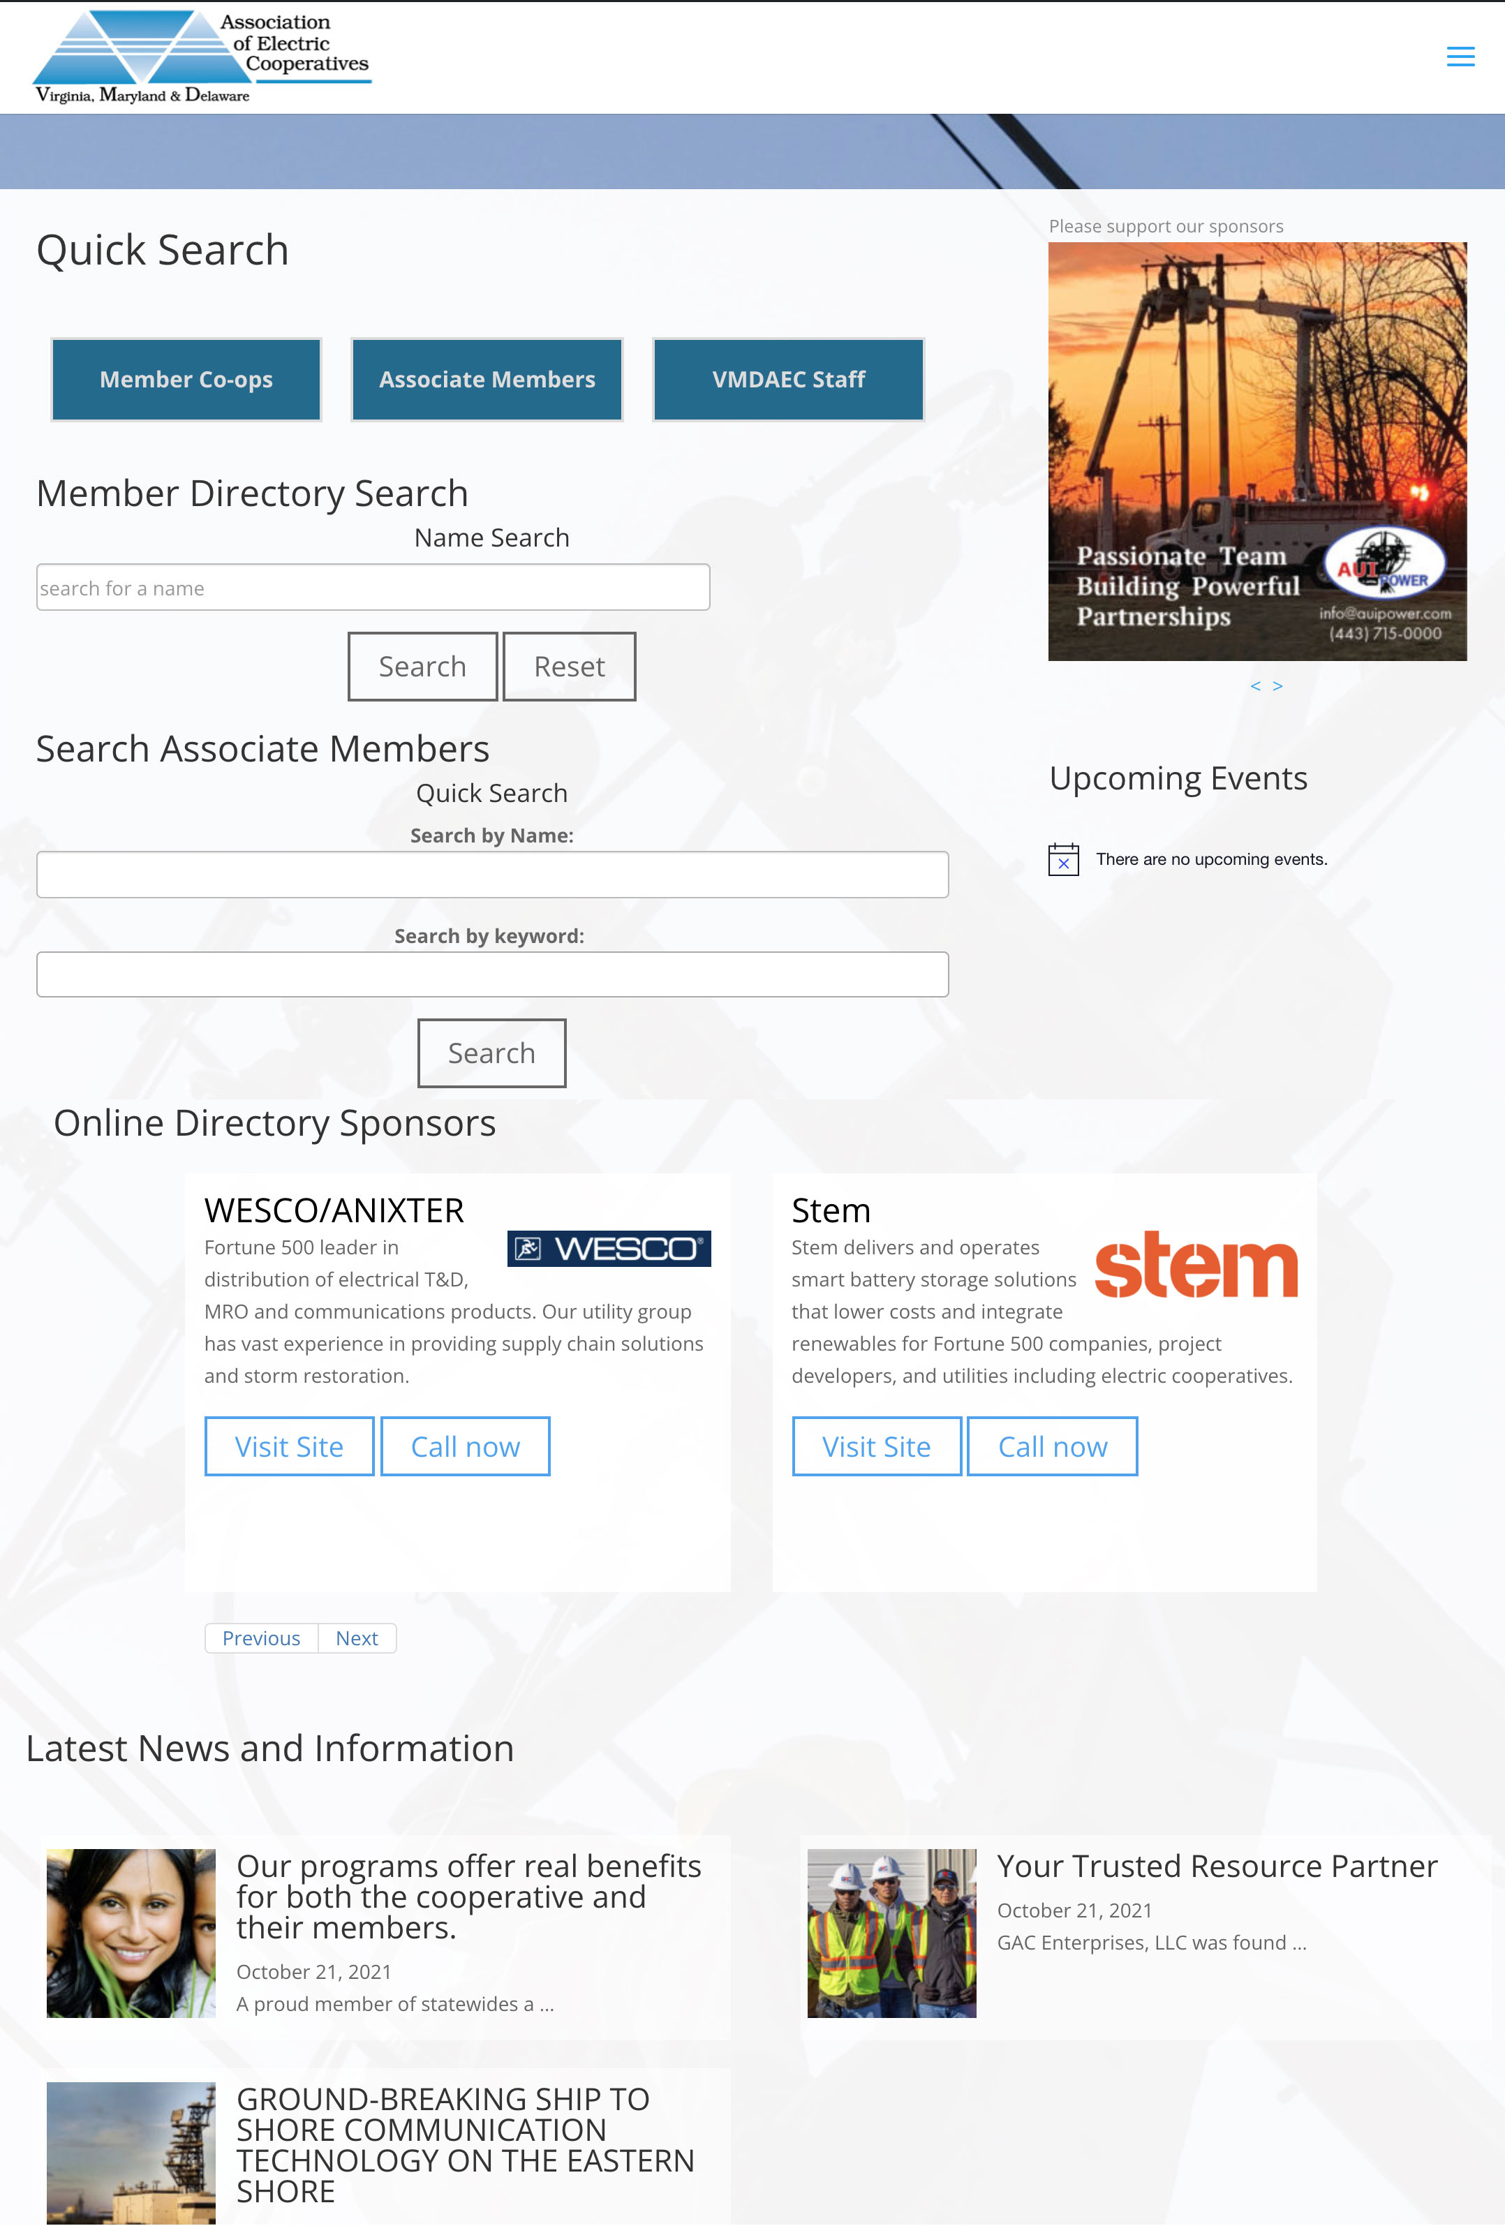
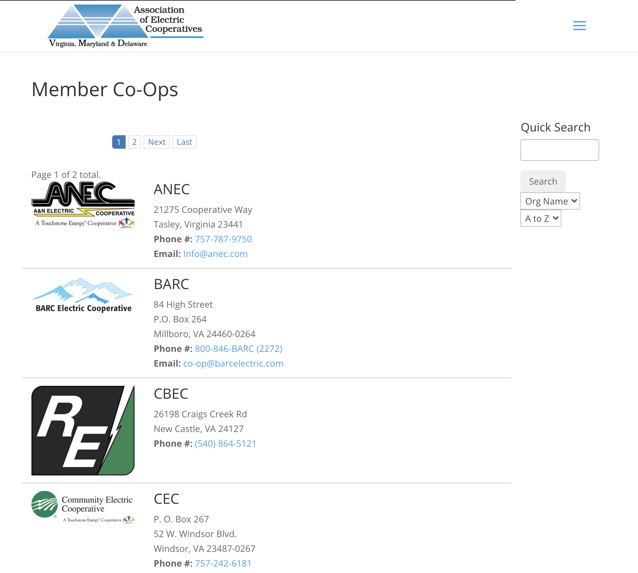
Online Directory
directory.vmdaec.com/
Coming in 2022
Replaces printed piece
Easy to use and navigate
Highlights Associate Members
Mobile friendly

Slide 7
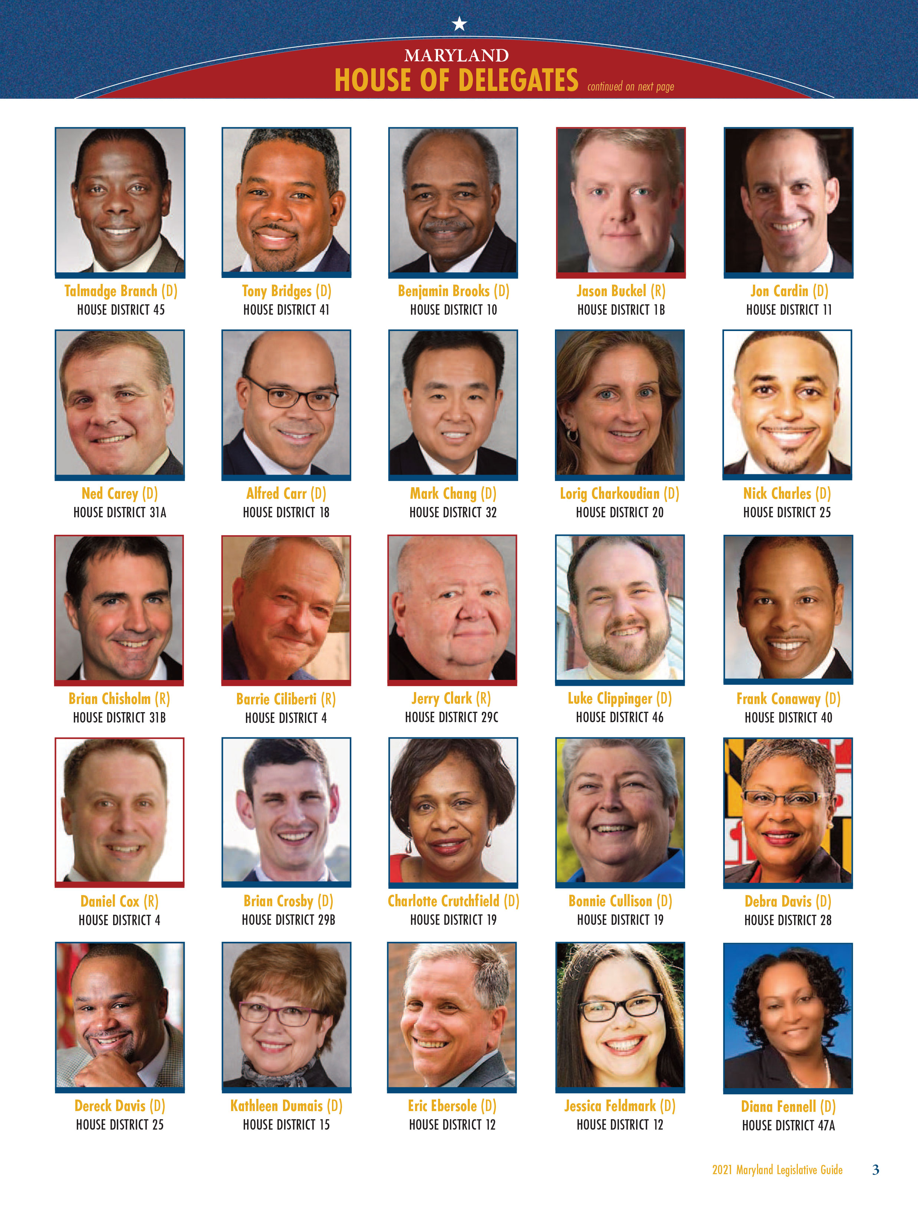
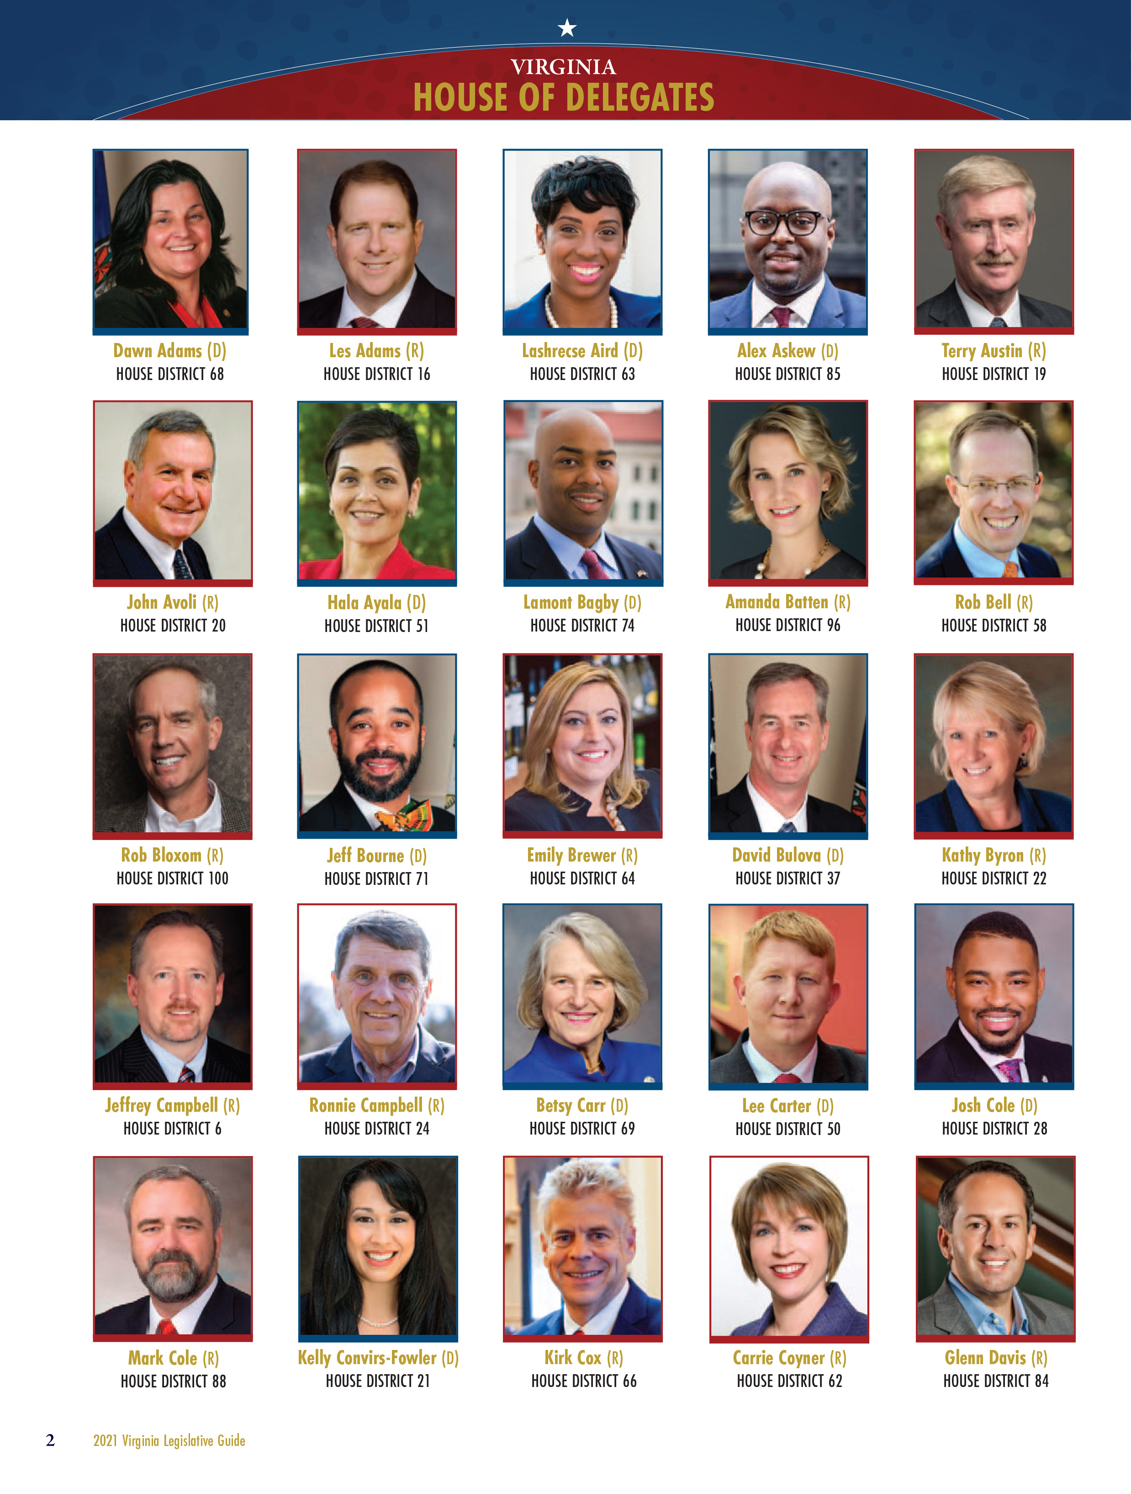
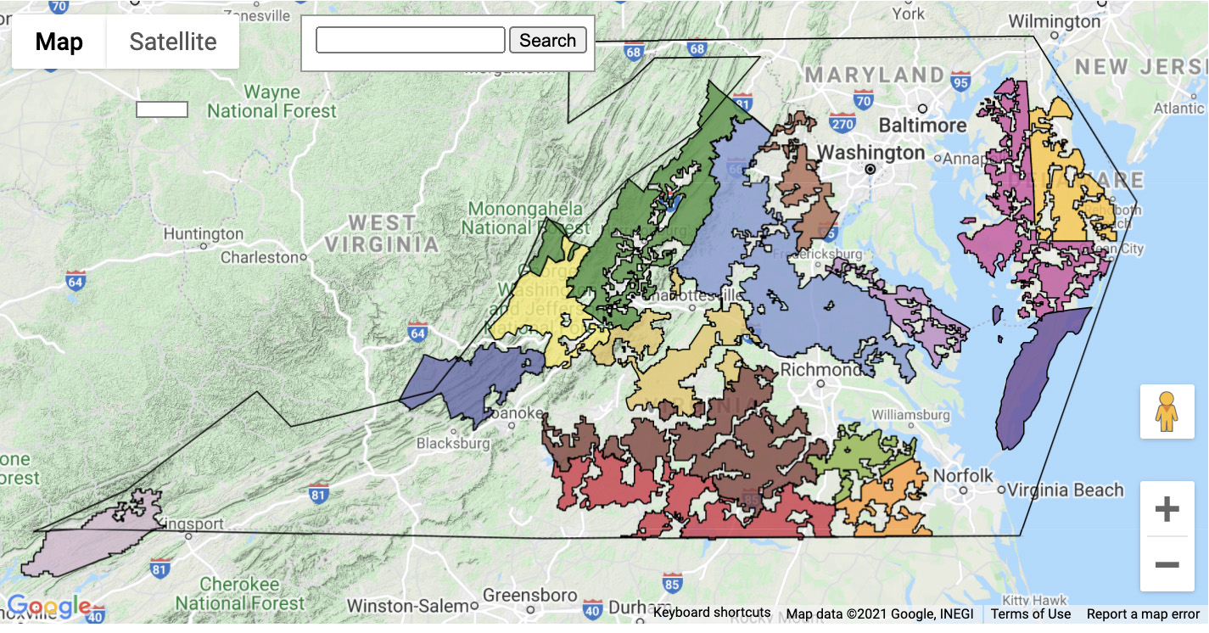
Legislative Guides
Coming in 2022
Replaces printed piece
Includes Legislators from each state – 1st time for Delaware
Updated along with each states legislative sites
Other interactive tools will be included

Slide 8
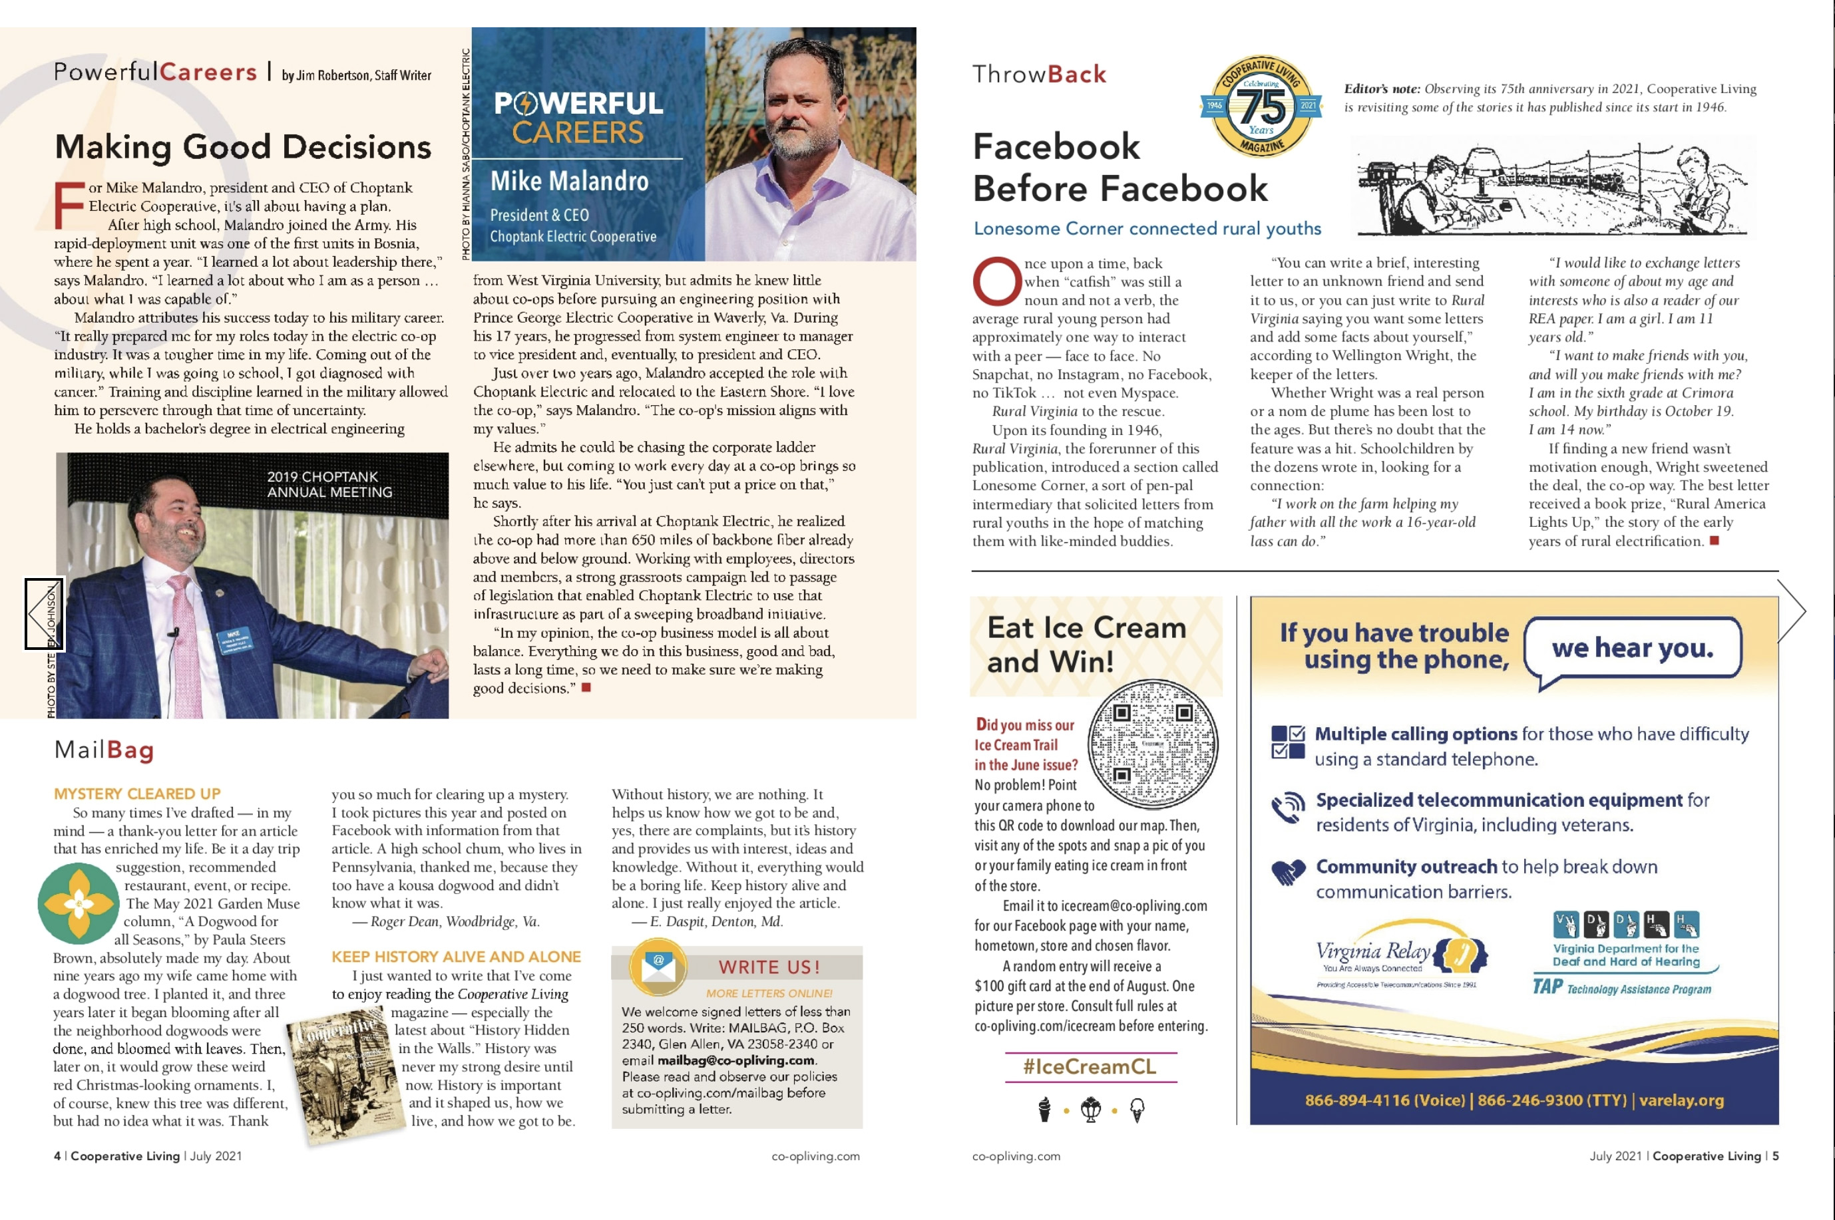
DigiMags
Been in use for many years
Quad will allow us to add interactive features that you can not do in print
Videos, Links, surveys, etc.
Analytics on views and readers available

Slide 9
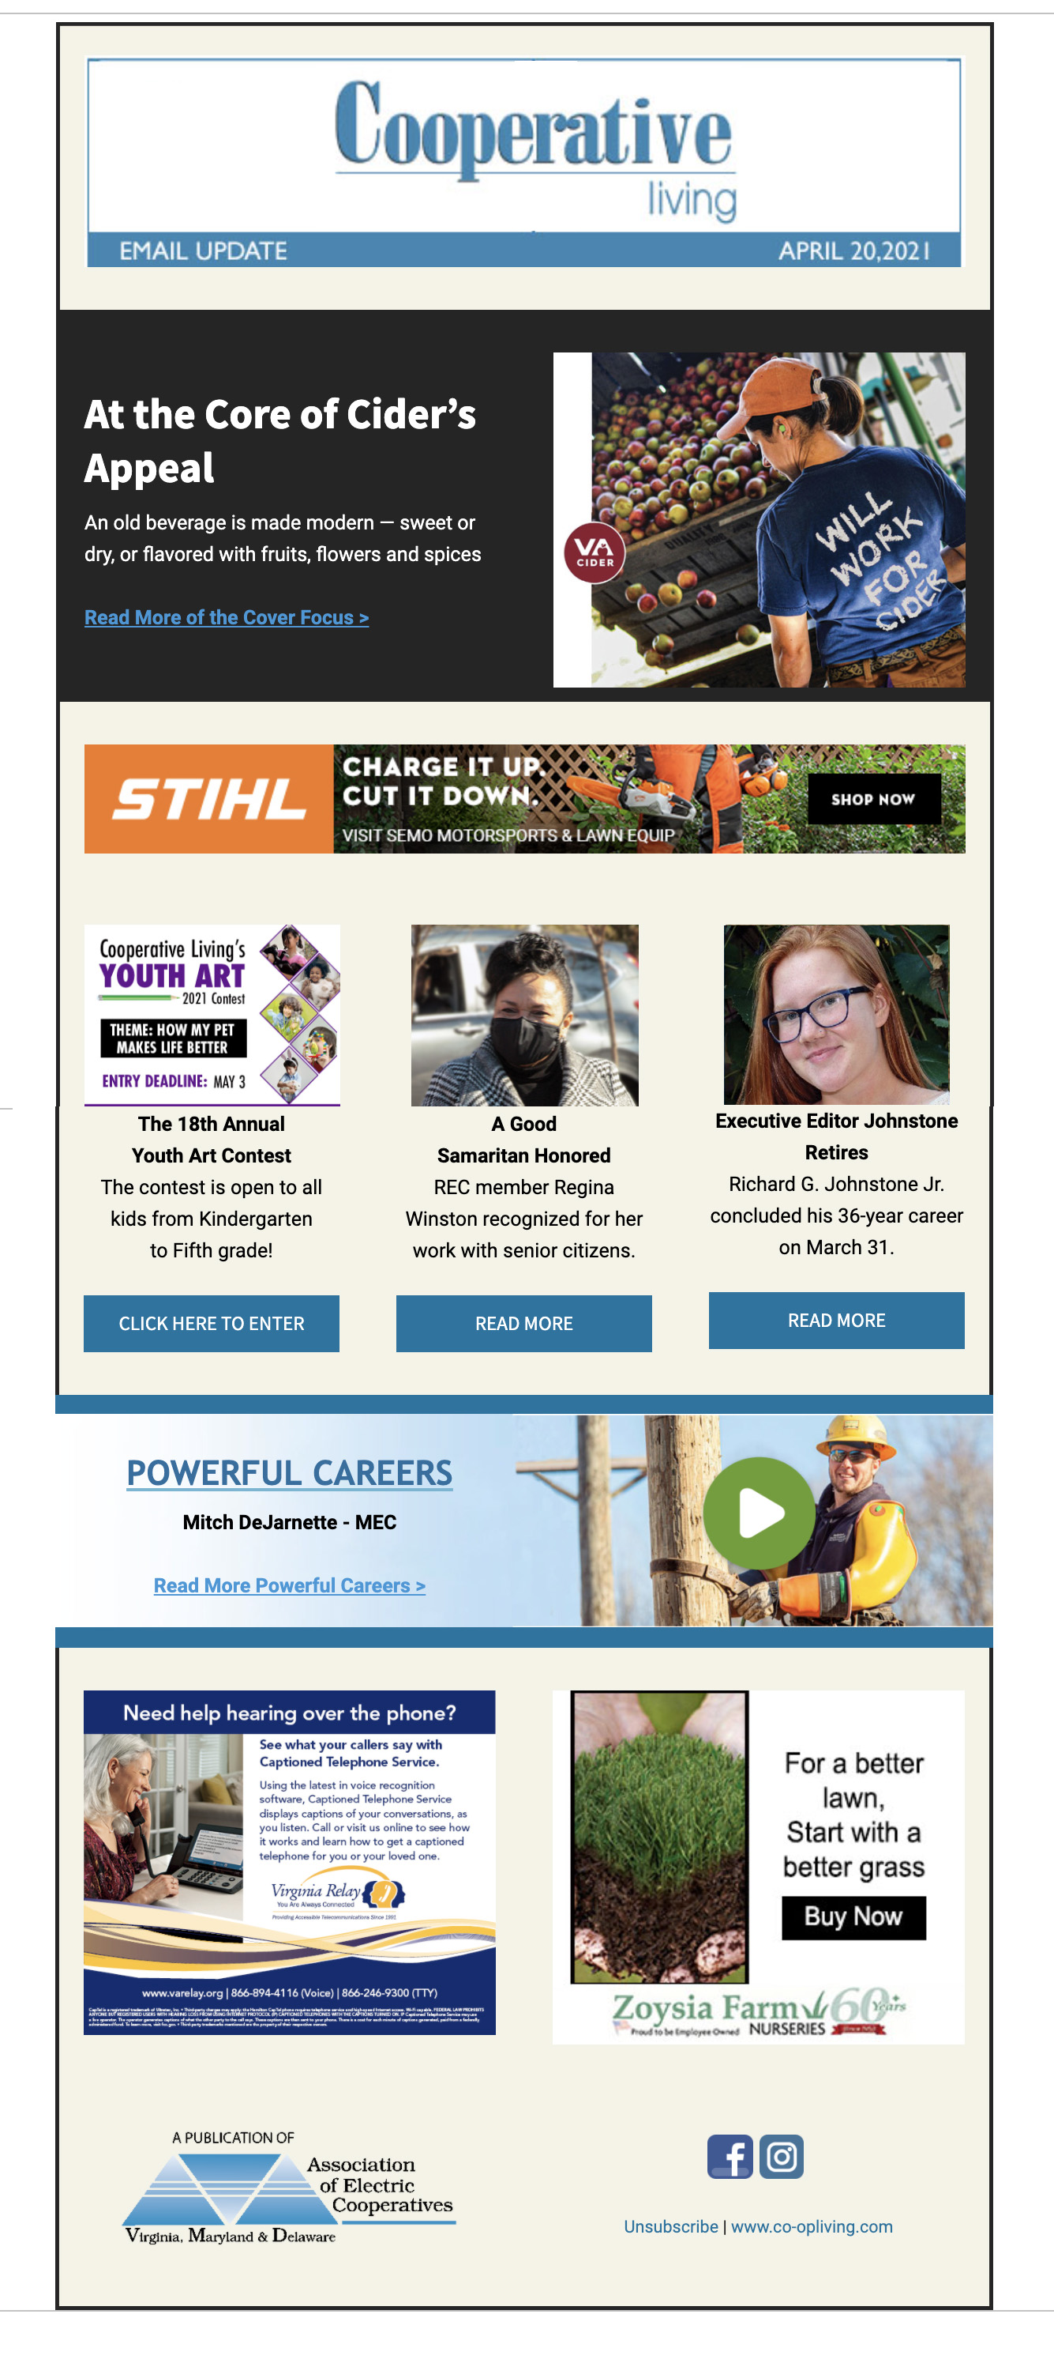
E-newsletters
Sent out twice a month
Email list collected from co-opliving.com
Highlight pieces from the current or upcoming magazine
Include updates to stories or links to more information
Showcase sections from our sites
Events will be highlighted with links to register or sponsors
Advertising opportunities

Slide 10
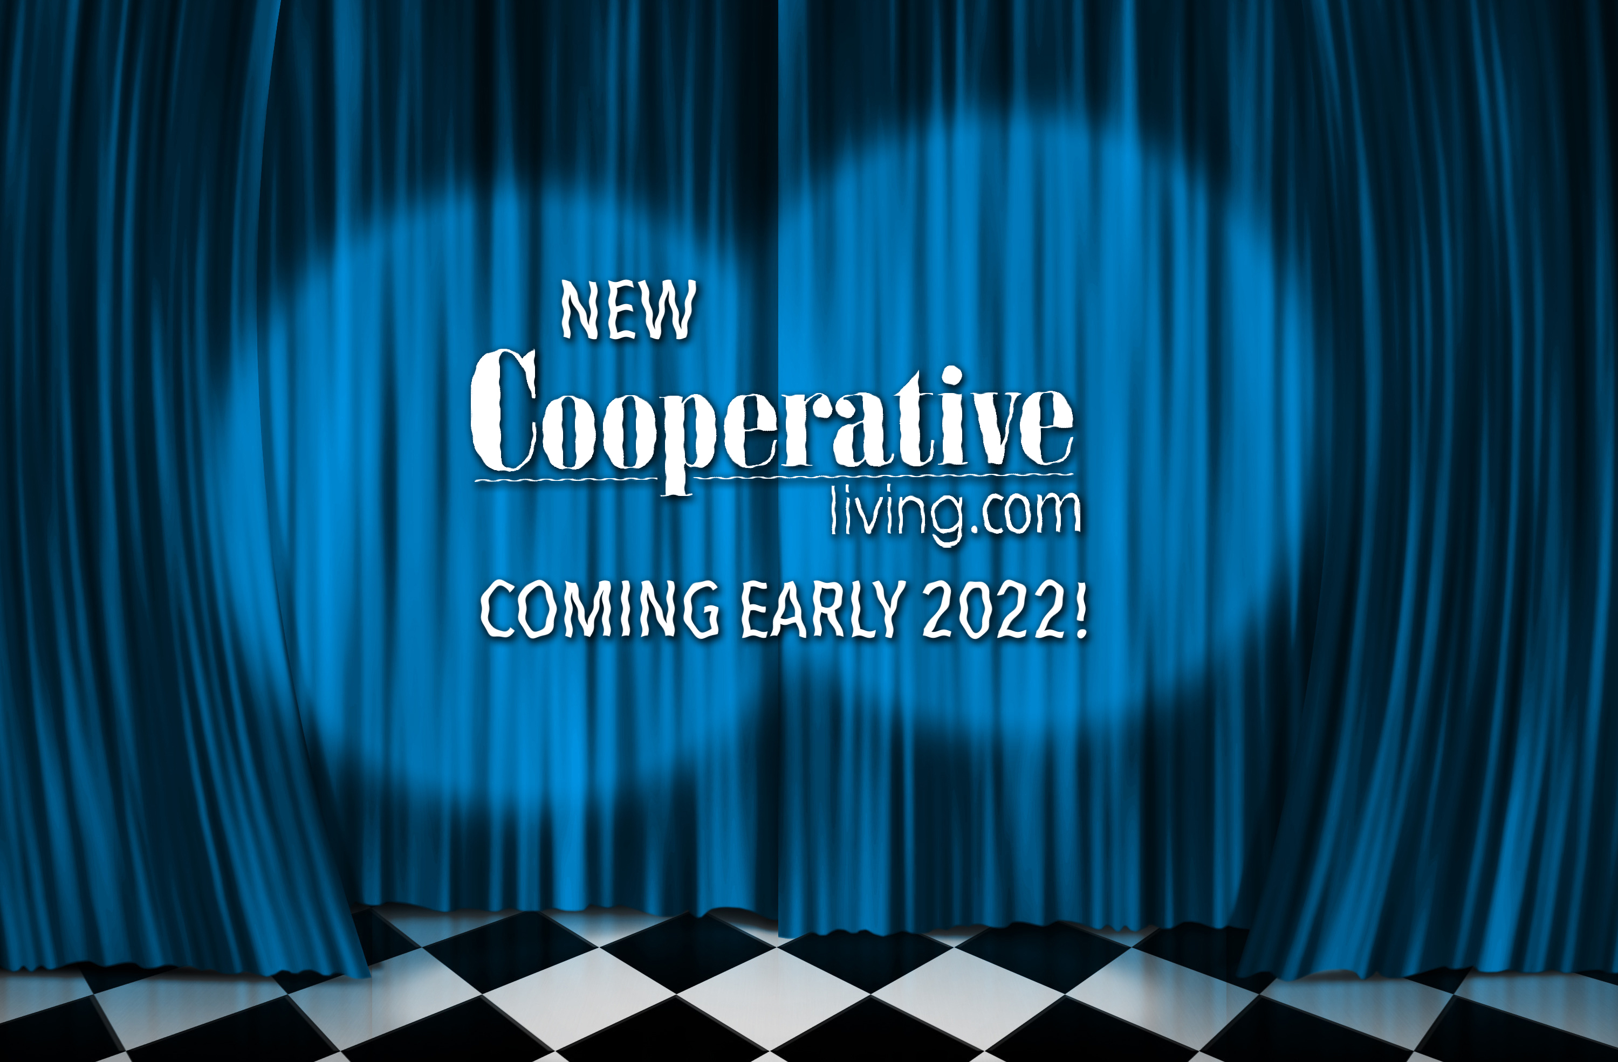
Co-opliving.com redesign
NEW FOR 2022! (Finally)
New look! More features!
More of a community and lifestyle focus
More content from the stories in the issues of the magazine
Additional photos, videos, links, etc.
Web only content
More interactive features
Contest only online
Updated frequently – will keep visitors coming back.
A lot more exciting features to come!

